Slide 1
Unicef/choufany
Notes:
On 1 September 2020, Kevin, 8 years old, left, with his mother Nadida Kayyal Bakli and brother at the UNICEF's children friendly space (CFS) at the Karantina public garden in Beirut, Lebanon.
Unicef/Choufany

Slide 2
Contents
Contents
Slide 3 Guess the article - images as clues to identify the article
Slide 4 Introducing the article
Slide 5 Exploring Article 3 – the question
Slide 6 Exploring Article 3 – the answers
Slide 7 & 8 Primary activities
Slide 9 Reflection
Slide 10 Extension

Slide 3
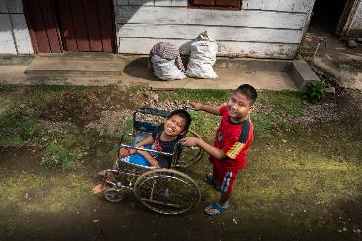
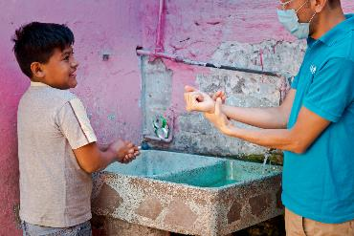
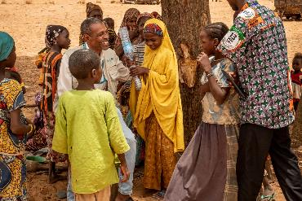
Guess the article
These pictures provide a clue to this week’s article.
Can you guess how they are linked together? Which article of the Convention do these pictures relate to?
Write down your thoughts or discuss with someone in your home.
Unicef/Ijazah
Unicef/Armando
Unicef/Gilbertson
Notes:
From left to right:
Unicef/Ijazah - Syaiful (left), 12, a child with a physical impairment, and his best friend Kevin Saputra (right), 9, a child with a visual impairment, play outside near Syaiful's house in Banyumas, Central Java, Indonesia. Syaiful cannot freely move his lower body or his right hand.
Unicef/Armando - A Unicef member of staff demonstrated good handwashing practice with a child in Mexico.
Unicef/Gilbertson - Ramatou (yellow veil), 12, an unaccompanied minor is returned to her father Bahari Inoussa (not pictured) and brothers and sisters in a tiny village in Niger. Moussa, a child protection officer from UNICEF sits with her, and a social worker is on the right.

Slide 4
Introducing… Article 3
Gerry introduces Article 3 - Best interests of the child
Article 3 – Best interests of the child
The best interests of the child must be a top priority in all decisions and actions that affect children.
Watch Gerry on YouTube

Slide 5
Exploring Article 3
There are many adults involved in making decisions that affect your life. Give yourself one minute to think of as many types adults as you can.
At the end of one minute share your thoughts.
Then compare with the ideas on the next slide.

Slide 6
How Did you get on? Did your thoughts include any of these?
Parents or carers
Other family members
Teachers
Healthcare workers
Social workers
Sports coaches
Youth workers
Police officers
Members of the government
Courts officials – judges, lawyers
They should all put your best interests first when they make a decision that affects you, considering every part of your life, including your safety, your education, your views and your relationships with people in your family.

Slide 7
Activity time
Think about how families involve their children in decisions. “What to have for dinner?” and “Should we move house?” are very different types of decision. Do you think all parents and carers are relaxed about involving young people in decisions? What advice would you give adults to make them better at this?
These activities will help you
understand how...
…can relate to your life.
You don’t need to do every activity, just do as many as you can.
If adults - who might not know you - have to make decisions in your best interest what should they think about?
Over the summer lots of things have changed in your school. These decisions were taken in your best interest. Can you list what changes have been made and why they are important.
Secondary

Slide 8
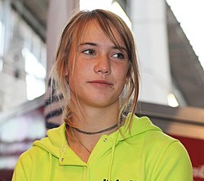
Activity time
Don’t forget you should be involved in decisions about your best interest. Write a letter to your headteacher or your local MP explaining how you would like to be involved in the decisions that affect you.
What is in your best interest may not be the same for all young people in your class or school. Identify three examples where there is a difference between your best interest and those of others.
. Dutch teenager Laura Dekker was given her first yacht at the age of six and she became a very skilled sailor. When she was 14, a court in The Netherlands gave Laura permission to sail around the world alone. She had been stopped from doing this before because there were worries about her welfare. Do you think the court's decision was in Laura's best interests?
Governments often make decisions that affect many children. Over the summer holidays governments decided that secondary school pupils should wear masks in school. Do you think this is a good idea? Can you explain your view-point?
Secondary
wikicommons

Slide 9
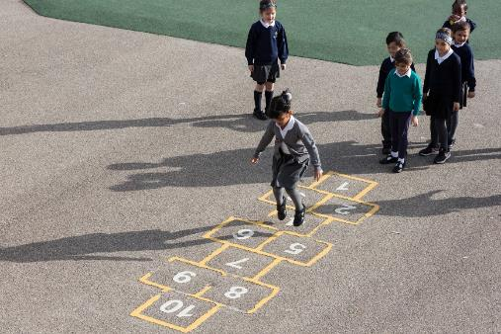
Reflection
Find somewhere quiet and give yourself some space to think:
Who are the adults you trust to make decisions in your best interests?
Think about how they involve you in the decision.
Can you think of decisions made or instructions given to you by adults which you don’t like but you know they are right?
Uncief/Dawe

Slide 10
Extension
Making decisions in the best interest of a child should normally involve listening to the views of the child or young person before making the decision.
Article 12 says that a child or young person should have a say in all matters that affect them.
What other articles could or should be considered for the best interests of the child to be achieved?
You can find a summary of the whole Convention here.
UNICEF/Dawe

Slide 11
Thank you

