Slide 1
Unicef/Matas
Notes:
Jordan, March 2020. UNICEF and partner organisation, RHAS, have established an Environment Action Club and will improve the WASH infrastructure for the school so that it can reach national standards in 2020 as part of the WASH in Schools programme.
Unicef/Matas

Slide 2
Contents
Slide 3 Guess the article - images as clues to identify the article
Slide 4 Introducing the article
Slide 5 Exploring Article 45 – the question
Slide 6 Exploring Article 45 – the answers
Slide 7 & 8 Activities
Slide 9 Reflection
Slide 10 Extension

Slide 3
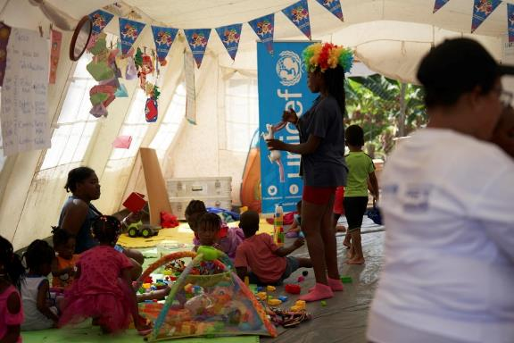
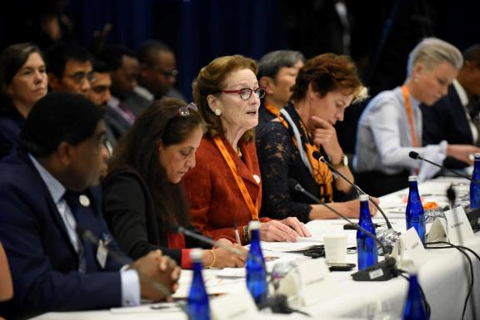
Guess the article
These pictures provide a clue to this week’s article.
Can you guess how they are linked together? Which article of the Convention do these pictures relate to?
Write down your thoughts or discuss with someone in your home.
Unicef/Urdaneta
Unicef/Berkwitz
Notes:
From left to right:
Unicef logo
Unicef/Urdaneta - Migrant and host community children resting at UNICEF´s Child Friendly Space in migrant shelter in Panama.
Unicef/Berkwitz - New York, Henrietta Fore, UNICEF Executive Director and Chair of the SUN (Scaling Up Nutrition) Movement Lead Group, speaks at the Group's annual meeting at UNICEF House during the 74th session of the UN General Assembly.

Slide 4
Introducing… Article 45
Frances introduces Article 45 - Unicef can provide expert advice and assistance on children’s rights.
Article 45 – Unicef can provide expert advice and assistance on children’s rights.
Watch Frances on YouTube

Slide 5
Exploring Article 45
In what different ways does Unicef help children around the world?
Note your ideas down and then compare your thoughts with the next slide.

Slide 6
How many of these did you get?
UNICEF…
works within the United Nations and with governments and civil society to make sure children’s lives and views are visible and taken in to account.
works with governments to make sure that all children have an education, access to clean water and nutritious food and good health and are protected.
helps governments all around the world to look at how children’s rights are being met and helps them improve the situation for children.
provides help for children when there is an emergency situation such as an earthquake, hurricane or tsunami.
provides help for children if there is a war to make sure children are looked after.
Unicef UK promotes children’s rights, raises funds to support UNICEF’s work and makes issues about children’s lives visible.
What else did you think of?

Slide 7
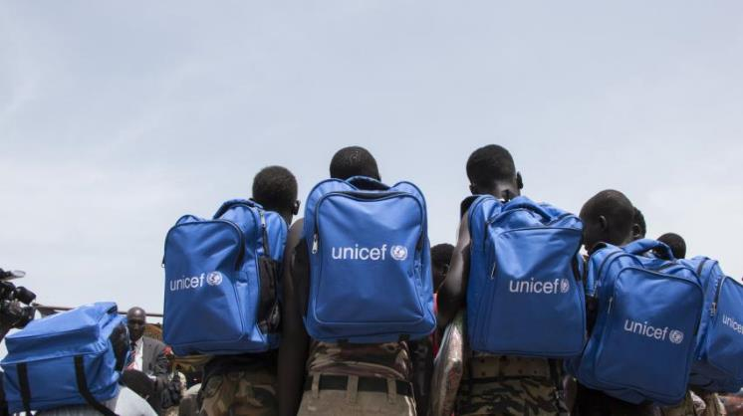
Activity Time
Have a look on the Unicef UK website find out more about Unicef UK’s work. What do you think is most interesting? Identify five facts to share with someone in your class.
All these activities are related to…
Draw a poster to advertise UNICEF’s work to other children.
Do you know what UNICEF stands for? Find out when and why it started and what it does here.
You don’t need to do every single activity
but if you have time you can do more than one.
Primary
Unicef/Bullen Choi

Slide 8
Activity Time
In September Unicef UK and ITV hosted Soccer Aid for Unicef to raise funds for UNICEF. If you like football you might be able to watch some of the match on ITV hub. Find out what Soccer Aid is about and write a report of the match or programme.
.
Look out for how many times you can see or hear Unicef’s work described in the news, TV or online over two weeks. Ask other members of your family to help you.
.
There are lots of people who support Unicef’s work. Some of them are very well known. Choose one of the Unicef UK ambassadors and find out what they have done to support Unicef UK. Write them a letter or a thank you card appreciating their work. The Unicef UK postal address is online if you would like to post your card or letter.
.
Watch this video to find out about UNICEF’s work on education. Choose one of the stories to tell to someone else.
Primary

Slide 9
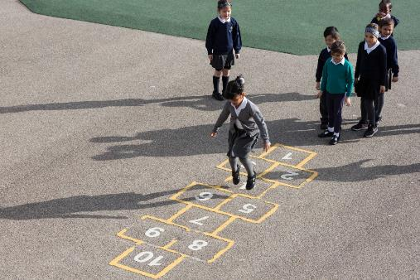
Reflection
Try to find somewhere peaceful and spend a few minutes being quiet and still … then think about these questions…
Think about all the amazing things that Unicef does to make life better for millions of children around the world every day.
What have you learned about Unicef’s work?
What will you do to tell other people about Unicef’s work?
Uncief/Dawe

Slide 10
Extension
UNICEF works to protect the rights of every child everywhere.
Look at the Convention and try and find examples of how and where UNICEF has supported different articles. Pick a couple of articles that seem most important to you rather than doing them all.
You can find a summary of the whole Convention here.
UNICEF/Dawe

Slide 11
Thank you

