Slide 1

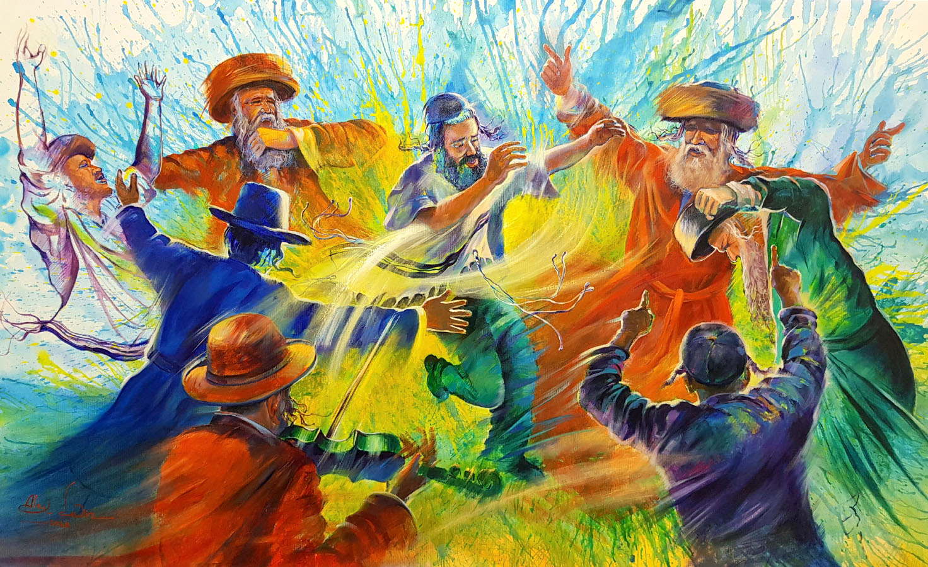
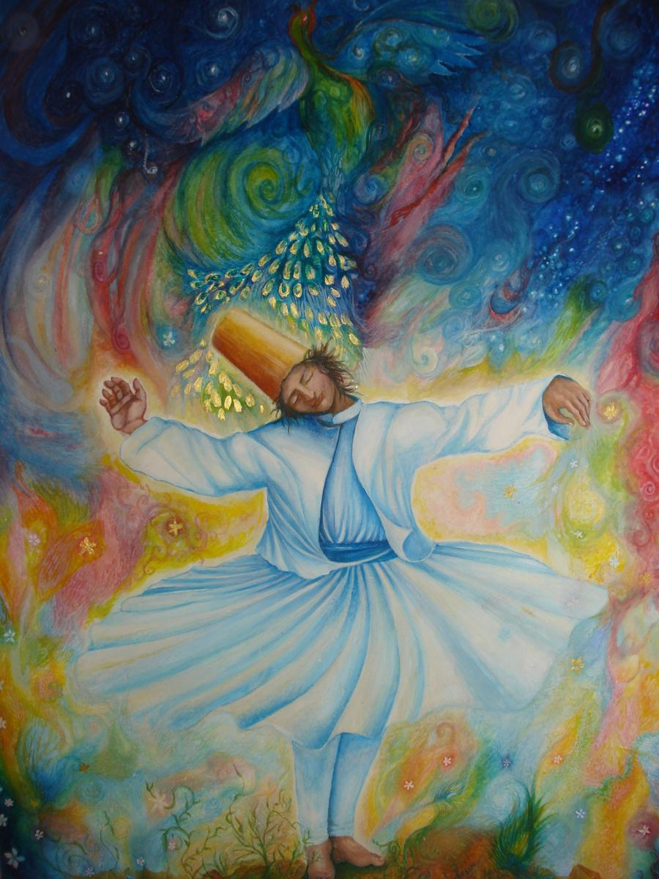
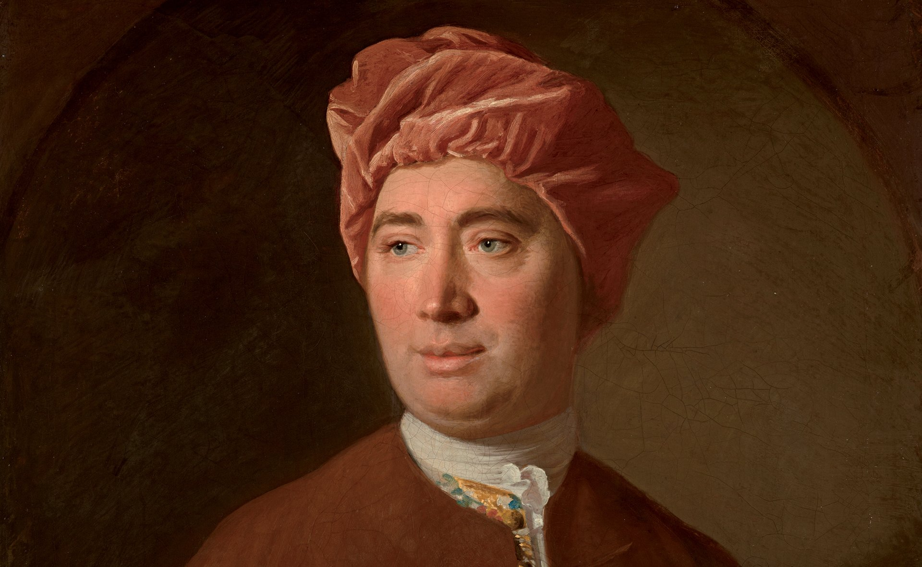
Click on your chosen area from the RMPS Department:
National 5 RMPS
Higher RMPS
Advanced Higher RMPS
Higher Philosophy

Slide 2
National 5 RMPS Skills
What Skills?
What is this skill?
Knowledge
Analysis
This is any impact that a belief, practice or a source has on the life/teachings of an individual or society.
E.g. an impact of this practice could be that many people see the selecting out of genetic conditions could be seen as a new form of eugenics, resulting in many disabled people feeling that their lives are of less value. Where do we draw the line?
Evaluation
Examples of how this skill might look in your answer.
A Knowledge mark is given for a point which is relevant to the question, is accurate and it is developed.
This is where you respond to a viewpoint with arguments either supporting the viewpoint or rejecting it. These skills questions are worth 8 marks. The easiest and most effective way is to provide 4 arguments in agreement with the statement and 4 arguments to refute the statement.
E.g. One way in which Jews keep the covenant is through the practice of Brit Milah. This is a celebratory practice of male circumcision at 8 days old, this usually takes place in the Synagogue on Shabbat.
E.g. On the one hand I agree that science has removed the possibility of miracles taking place. Firstly, psychology has shown that …
POINTS TO REMEMBER:
Keep an eye on how many marks each question is worth.
There are usually 14 knowledge marks
4 Analysis marks and 8 evaluation marks
How Can I Improve?
Make flashcards on all the key terms and definitions and ask your family to test you
Mind Map any practices/impacts and consequences of beliefs stemming from a source or a teaching.
All course notes, revision booklets and clips are on Teams. You can ask your teacher any question on the course via Teams.
Use the 8 marker templates to help prepare for any evaluation question. Remember On the one hand x4 on the other hand x4

Slide 3
Higher RMPS Skills
What Skills?
What is it?
Knowledge
Analysis
Analysis marks are awarded to any relevant, accurate and developed points which show an impact/consequence/development of quotes etc.
E.g. a consequence of the belief in B’Tzelem Elohim means that Jews see every single human on this planet as having equal value and worth, and as a result of this, Jews will participate in Social Justice – caring for others. This was evident in the strong Jewish presence during the Black Lives Matter movement and in the campaign in Scotland for Equal Marriage. Jewish people see it as their duty to stand up for others as every single person is B’Tzelem Elohim.
Evaluation
Example
A Knowledge mark is given for a point which is relevant to the question, is accurate and it is developed.
E.g. One key belief in the nature of humans is the concept of B’Tzelem Elohim. This translates as Made in the Image of God. This does not mean we look like God, but that we share his characteristics, such as being able to form relationships, be compassionate and be creative.
Evaluation marks are awarded when you make a judgement that is relevant to the question, is accurate and detailed. You can do this by pointing out positive or negative aspects of a view/source, strengths and weakness or explaining whether something is relevant, significant or ethical.
E.g. I think it could be justifiably argued that the covenant is not relevant in 2020. this is because the Abrahamic and Mosaic covenants demand the process of Brit Milah. I think that circumcision of an 8 day old boy is a barbaric act. This is because there is no way the baby can consent to this irreversible and dangerous act.
How Can I Improve?
POINTS TO REMEMBER
10 marks questions expect you to focus on analysis
6KU Marks
4 Analysis Marks.
If you do not apply any analysis skills, then your essay is capped at 4 marks.
Make flashcards on all the key terms and definitions and ask your family to test you
Write out a quote/teaching in the middle of an A4 page. Mind map – what does this mean? What is an impact/practice related to this?
All course notes, revision booklets and clips are on Teams. You can ask your teacher any question on the course via Teams.
Use clear indicators that you are doing evaluation.

Slide 4
Advanced Higher RMPS Skills
What Skills?
What is it?
Knowledge
Analysis
Analysis marks are awarded when you have clearly shown a strong understanding of a source and its purpose. You should show a strong understanding of alternative viewpoints and interpretations of concepts or sources.
Evaluation
Example
Knowledge marks will be allocated when your points are consistent, have depth are accurate and well developed.
Synthesis
E.g. A mystical religious experience is where the person feels a sense of union with God these can be ineffable and noetic and are found in all religions which emphasise personal revelations such as visions and dreams. Saint Teresa of Avila is an example of someone who received many mystical experiences; she felt that God was within her.
E.g. This source by Dawkins clearly shows that he is against the idea that a God exists arguing that belief in God is simply attempting to fill some sort of void in our lives, and people are therefore just filling that with God. He argues that we can find meaning and purpose ourselves. Dawkins’ use of the word ‘presumption’ indicates that …..
In Evaluation you are expected to assess the validity or invalidity of the perspective as set out in the source. You should be able to explain, in depth, the strengths and weaknesses of viewpoints, provide counter arguments to viewpoints and criticisms. All points should be well supported.
E.g. I agree with Dawkins to a certain extent as I think that it is delusional to believe that human beings need to believe in God in order to provide them with a reason for living. Dawkins describes belief in God as ‘infantile’, which I would agree with because there is no convincing evidence to support the existence of God. I think it is very childish to need to believe in a higher power in order to find meaning, value and purpose in life. This is similar to a child needing guidance from a parent…
This skill demands that in a 30 mark essay you consistently maintain a clear line of argument by ensuring that you remain focussed on the question at all times
E.g. If your essay is analysing and evaluating the James’ definition of Religious Experience, you should refer back to his definition when comparing it to the likes of Otto and Swinburne.
What Skills?
POINTS TO REMEMBER:
Essay questions are work 30 marks. 10 KU, 10 Analysis and 10 Evaluation. This is marked holistically and synthesis is expected throughout.
Make flashcards on all the key terms and definitions and ask your family to test you
Use the list of SOURCES provided to mind map – remember to connect these to the main terminology used in KU.
All course notes, revision booklets and clips are on Teams. You can ask your teacher any question on the course via Teams.
Use Jigsaw style evaluation revision for each key theory in the course
Practise writing source questions and essays. Keep asking, does my point refer to the question?

Slide 5
Higher Philosophy Skills
What Skills?
What is it?
Knowledge
Analysis
Analysis marks are awarded to any relevant, accurate and developed points which show an impact/consequence/development of quotes etc.
E.g. Descartes believes that The Cogito can be considered certain knowledge as it is a “self-authenticating” statement. This means that by even contemplating it we affirm its truth. It would also involve us in a logical contradiction if we tried to deny it – you can’t say truthfully that you don’t exist.
Evaluation
Example
A Knowledge mark is given for a point which is relevant to the question, is accurate and it is developed.
E.g. Descartes’ aim was to find a piece of certain knowledge that could survive all sceptical doubt. In his second meditation, Descartes believed he found this piece of knowledge in The Cogito – the statement ‘I am: I exist’.
Evaluation marks are awarded when you make a judgement that is relevant to the question, is accurate and detailed. You can do this by pointing out positive or negative aspects of a view/source, strengths and weakness or explaining whether something is relevant or significant.
E.g. However, I believe that Descartes does not use the same rigorous doubt that he has employed previously when arriving at The Cogito. Descartes had raised the idea previously that there could be a malicious demon who aims to deceive us, meaning we cannot trust anything we know. Descartes believes that he must exist in order to be deceived but does not consider the possibility that the evil deceiver has warped his understanding of what it means to exist.
How Can I Improve?
POINTS TO REMEMBER:
Essay questions are work 30 marks. This is marked holistically – you should ensure that you apply the skills in a clear logical manner.
Make flashcards on all the key terms and definitions and ask your family to test you
Write out a quote in the middle of an A4 page. Mind map – what does this mean? How does it support eg. Descartes’ theory?
All course notes, revision booklets and clips are on Teams. You can ask your teacher any question on the course via Teams.
Use Jigsaw style evaluation revision for each key theory in the course

