Slide 1

National 5
Study skills for THE written Exam

Slide 2
Question paper
The Drama exam is split into 2 separate sections-
Question paper, lasts 1 hour 30 minutes, is marked out of 60 and accounts for 40% of the overall mark for the course.
The purpose of the question paper is to assess application of knowledge and skills from across the course. It allows candidates to demonstrate their ability to interpret questions and respond in an informed way.
Section 1- is an evaluation of yourself and others either as an actor or in a production role. 20 MARKS
Section 2- where candidates respond to a stimulus and create a drama suitable for a performance. 40 MARKS

Slide 3
A key focus of the written paper is the candidates ability to use appropriate terminology in the correct context.
The paper assesses candidates’ ability to demonstrate the following skills, knowledge and understanding:
Responding to stimuli
Characterisation techniques
Character relationships and status
Performance concepts- Voice and Movement terminology
Design concepts
Form, structure and conventions
Presenting —application of concepts
Audience reaction
Analysis and evaluation skills of self and others
Genre and themes
Mood and atmosphere
Rehearsal techniques
Target audience
A range of production roles
Different staging, settings and styles of production
Problem-solving and critical-thinking skills

Slide 4
Section 1- Evaluation of self and others
In this section you will answer questions about a performance you have recently been involved in.
You will reflect on yourself and others- evaluating both the process and the performance. You must use correct Drama terminology and be able to comment on their individual preparation and/or final performance.
When commenting on preparation, you should be able to provide a description of the activity you participated in e.g. researching your theme, improvisations, hot seating etc.
When commenting on your performance, you should refer to your performance concepts for example voice and movement terminology.
When evaluating someone else, you can choose another pupil in your group or from another group. You must be able to evaluate their individual contribution to the rehearsal and/or final performance.
Please note- You must always write your responses from your perspective not your groups.

Slide 5
Section 2- Response to a stimulus
You will have three different stimuli to choose from.
Look at them all, choose the one that
1) gives you the most ideas
2) you can create a full drama from.
Read all the questions in section 2 before attempting to respond to the stimulus. This allows you to see the through line of the questions and avoid repetition.
Most questions have more than one part, (a), (b), (c) and so on, and each part is connected to the previous part.
Read all parts of a question to avoid repetition and consider the question as a whole before you answer.
In this section you must use correct Drama terminology and adjectives to give a clear response to the question.

Slide 6
Command words within the questions
Describe……..
You are being asked to describe, this means detail your answer as much as possible.
Explain.........
If you are asked to explain, this means to fully justify your answer using Drama Terminology.
Evaluate……..
If you are asked to evaluate , this means to judge the worth of something.

Slide 7
N5 Drama Checklist
The areas listed will be covered practically, however you need to be able to write about them and understand the terminology in preparation for your written paper.
Plot and setting (What happens in the drama? Where and when is it set? You should be able to discuss what venue, staging and set design you would use in order to make clear this setting.)
Themes and issues
Message
Voice and movement terminology!
Areas of the stage, types of staging and names of venues
Mood and Atmosphere (Be able to state what the mood and atmosphere will be at varying points in the drama and how you could use theatre production skills such as sound and lights to highlight this mood or atmosphere for the audience.)

Slide 8
Checklist- continued
Character and Character Relationships (Personality/Status/objective/ purpose. How did you use acting techniques or production skills to highlight this?)
Turning Point/Key Moments. (Identify and justify.)
Target Audience. (Identify and justify.)
Form/Genre/Structure/Style. (Identify and justify.)
Practical Activities- (What activities did you/could you do in order to understand a character/relationships/explore setting/theme/ message/mood, etc. – what did you learn?)

Slide 9
Checklist- Theatre Arts
Lighting
Sound
Remember, when discussing lighting and sound explain in terms of:
• % brightness
• Use of gels or no gels?
• Wash (general coverage)
• Fresnel/Flood/Profile Spotlight
• What area of the stage is lit?
• What volume?
• What moment?
Props
Set
Costume
Make-up and Hair
When considering costume, set design, props or make-up, discuss in terms of:
• Colour
• Condition
• Fabric/materials
• Fit
• Positioning of furniture and props on stage
• Style of clothes/furniture etc

Slide 10
SQA Past Papers
On the SQA website all National 5 Drama past paper question papers and marking schemes are available to down load (below is a link)
https://www.sqa.org.uk/pastpapers/findpastpaper.htm?subject=Drama&level=N5
Candidates who require additional arrangements or prefer to digitally access the paper can type directly onto the document in the following way-
1- Select the past paper you wish to complete
2- copy the barcode from the bottom of the paper into google
3- select “subject spell check on” from the results.
4- Save and type directly on to the question paper.

Slide 11
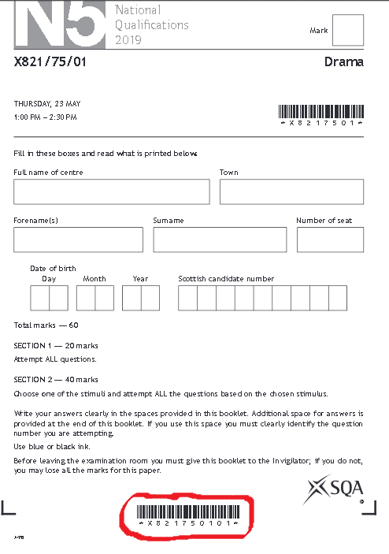
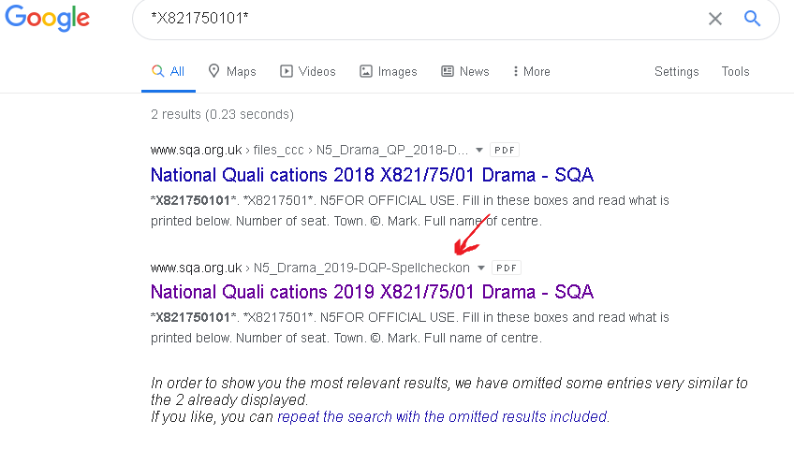
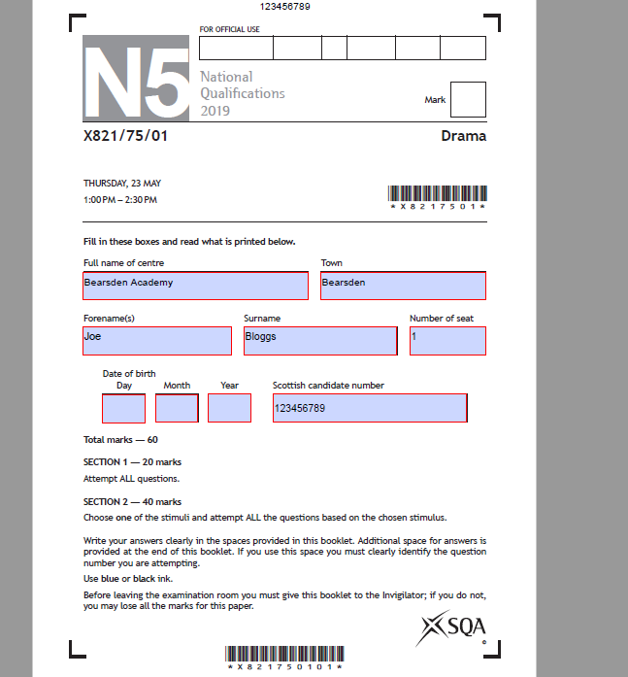
1
2
You will notice on image 3 the command boxes are highlighted in blue with a red outline, type directly into these as you can see from the image.
N.B this can be done for any subject past paper.
3

Slide 12
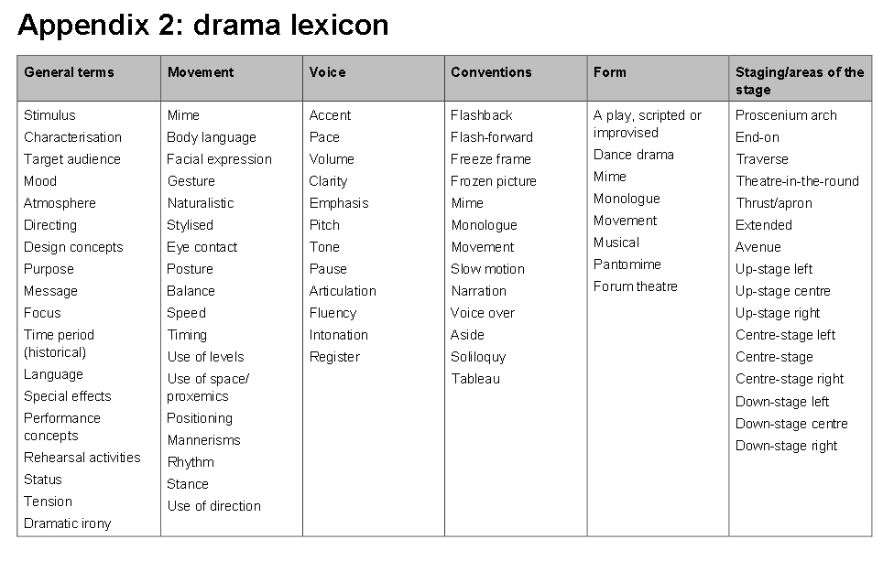
A guide to terminology

Slide 13
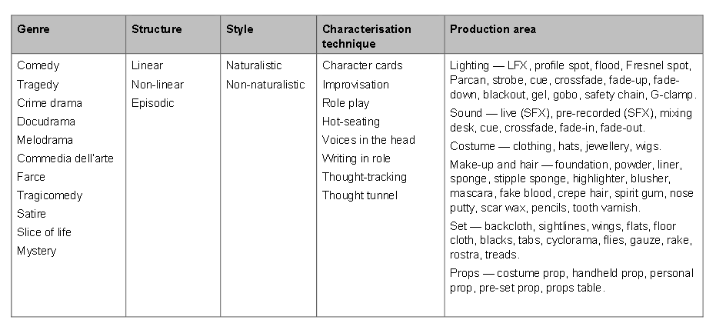

Slide 14

Good luck!

