Slide 1

SQA Study Skills for Physics
Bearsden Academy

Slide 2
How to Study in Physics
According to The Learning Scientists the six most effective strategies for successful learning are:
Spaced practice
consistent short study sessions over time
“one day, one week, one month”
Interleaving
switch between ideas during a single study session
change the order of topics between sessions
Elaboration
ask yourself questions about how and why things work
find the answers in your notes

Slide 3
How to Study in Physics - continued
Concrete examples
use relevant examples to help explain ideas
real-life examples
analogies
Dual coding
combine written/verbal materials with visuals
e.g. mind-maps
Retrieval practice
practise retrieving everything you know about a topic before you look at your notes, then compare
complete as many practice tests, quizzes and questions as possible

Slide 4

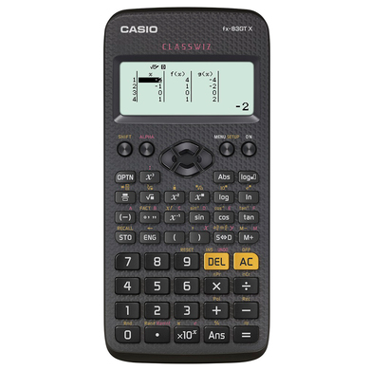

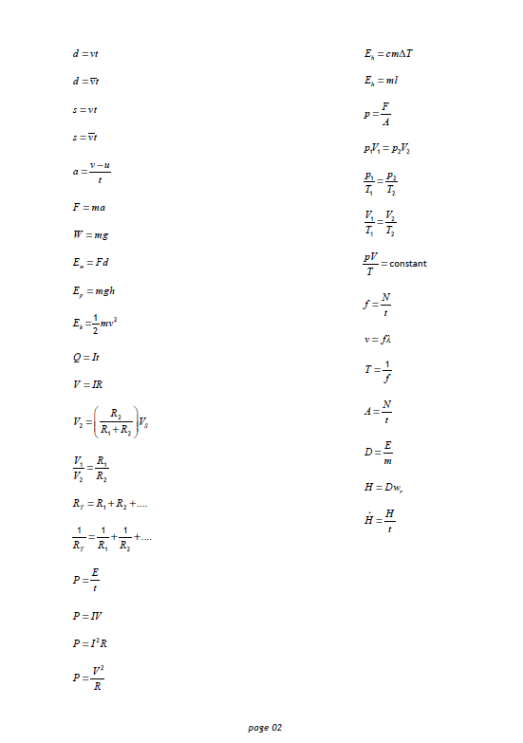
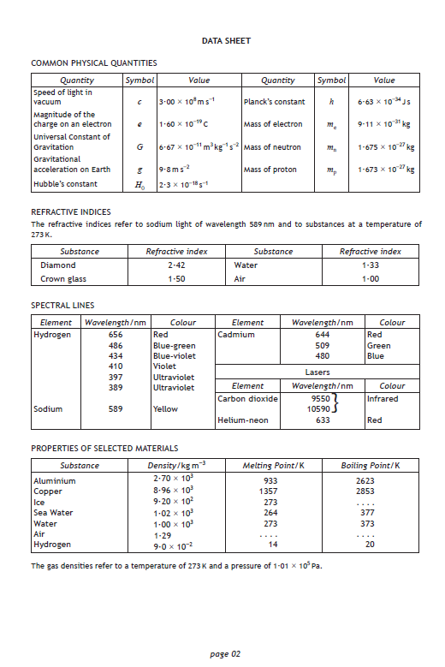
Equipment
Jotters (or lined paper) for:
making notes
doing problems
Scientific calculator
(preferably Casio FX-83 or FX-85)
PC/Laptop/Tablet
access to Teams and other online resources
development of ICT skills (e.g. Excel)
Copies of:
relationships sheet
data sheet (page 2 of exam papers)

Slide 5



Digital Resources
Satchel One (formerly Show My Homework) – details of formal homework and assessment tasks will be posted here
Teams – access to all resources provided in school via the ‘Files’ tab in General channel, discussion of class progress via relevant class channel
OneNote class notebook - classwork, personal workspace, collaborative workspace

Slide 6

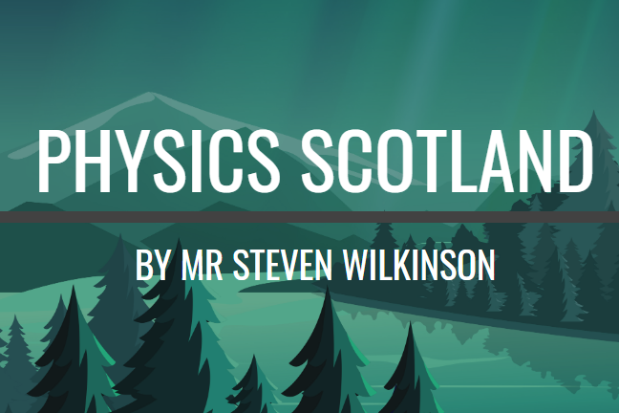

Revision Resources
BBC Bitesize – lessons, videos, quizzes and practice activities to help you with home learning
Physics Scotland – online lessons containing notes, videos and links to other resources, such as past papers
Scholar – complete interactive online course (animations, problems, quizzes, end of topic tests etc.)

Slide 7
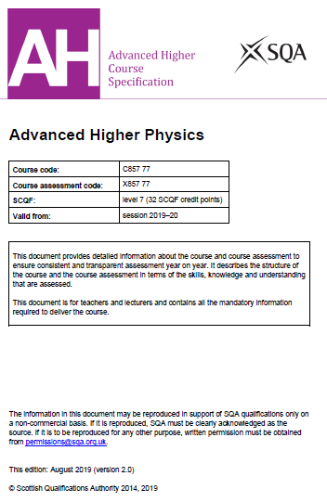
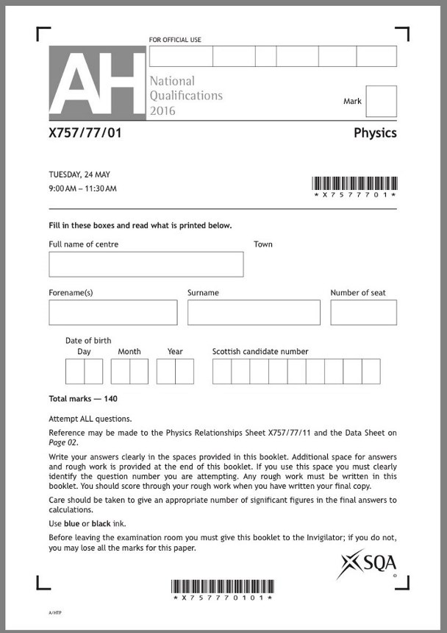
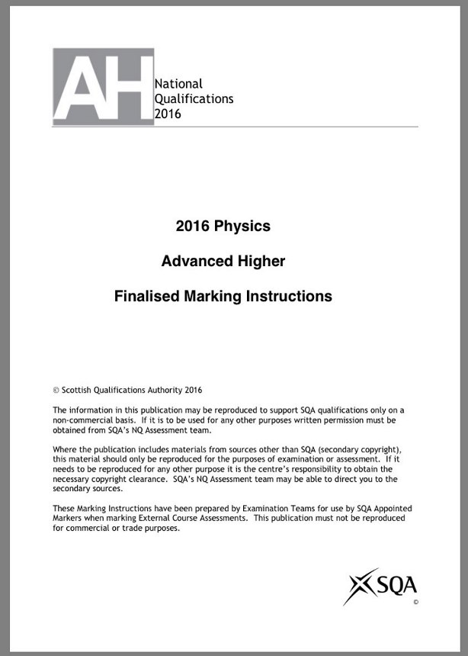
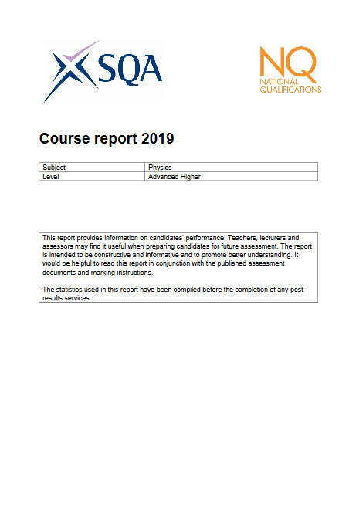
SQA Resources
Course Specification
Past Paper Questions
Marking Instructions
Course Reports

Slide 8
Other Useful Websites
Resources
Fizzics with Mr McKenzie
Marshallsay Physics
Mrs Physics
YouTube Channels
Mr Mallon’s Physics Channel
Mr Smith’s Physics online
Mr Mitchell Physics
Professor Dave Explains
Khan Academy
General Interest
minutephysics
Veritasium
Physics Girl

Slide 9
Some Suggestions
Write everything you know about a topic on a blank piece of paper, then compare to your notes. Repeat this regularly.
Make your own summary notes
Make flashcards (and use them to test yourself)
Create mind-maps (see How to Mind Map with Tony Buzan)
Do BBC Bitesize Quizzes
Do quizzes and tests on Scholar
Get a friend or family member to quiz you (e.g. using the summary sheets)
Do past paper questions (and compare to marking instructions)
Go through the relationships sheet and make a note of what every symbol stands for, as well as the units it is measured in

Slide 10
Command Words
The following command words are commonly used in SQA Physics exams:
State, Name, or Give – only need to name or present in brief form.
Describe – provide a statement or structure of characteristics and/or features.
Explain – relate cause and effect and/or make relationships between things clear.
Determine or calculate – determine a number from given facts, figures or information.
Estimate – determine an approximate value for something.

Slide 11
Command Words – continued
Justify – give reasons to support suggestions or conclusions, for example, this might be by identifying an appropriate relationship and the effect of changing variables.
Show that – use physics (and mathematics) to prove something, for example, a given value.
Predict – suggest what may happen based on available information.
Suggest – apply knowledge and understanding of physics to a new situation. A number of responses are acceptable: marks will be awarded for any suggestions that are supported by knowledge and understanding of physics.

Slide 12
Command Words – continued
Using your knowledge of physics or aspect of physics, comment on – apply skills, knowledge and understanding to respond appropriately to the problem/situation presented, for example by making a statement of principle(s) involved and/or a relationship or equation, and applying these to respond to the problem/situation.
These are known as open-ended questions.
Marks awarded for demonstrating understanding:
none = 0
limited = 1
reasonable = 2
good = 3

Slide 13
Command Words – Calculate/Determine
Where a question asks you to calculate or determine a value it is good practice to show all the stages in your working to maximise your chance of gaining marks:
Relationship
(use relationships sheet to check)
Substitution
(convert any p, n, μ, m, k, M, G or T)
Answer
(round to an appropriate number of significant figures at end, usually two or three)
Unit
(e.g. m s⁻¹, J, kg)

Slide 14
Command Words – Justify/Must justify
“Justify your answer”
mark available for the effect regardless of any justification
correct effect + no justification = 1 mark
incorrect effect = 0 marks (regardless of justification)
“You must justify your answer”
mark only available for the effect if a justification is attempted and does not contain any incorrect physics
correct effect + no justification = 0 marks
incorrect effect = 0 marks (regardless of justification)
incorrect physics in justification = 0 marks

Slide 15
Command Words – Show
Where a question asks you to ‘Show that’ an answer you must show all relevant steps:
start with a relevant relationship – if no relationship is shown then no marks for the entire question
show all substitutions
end with a final answer and unit, exactly as given in the question (rounded to the same number of significant figures)

Slide 16


