Slide 1



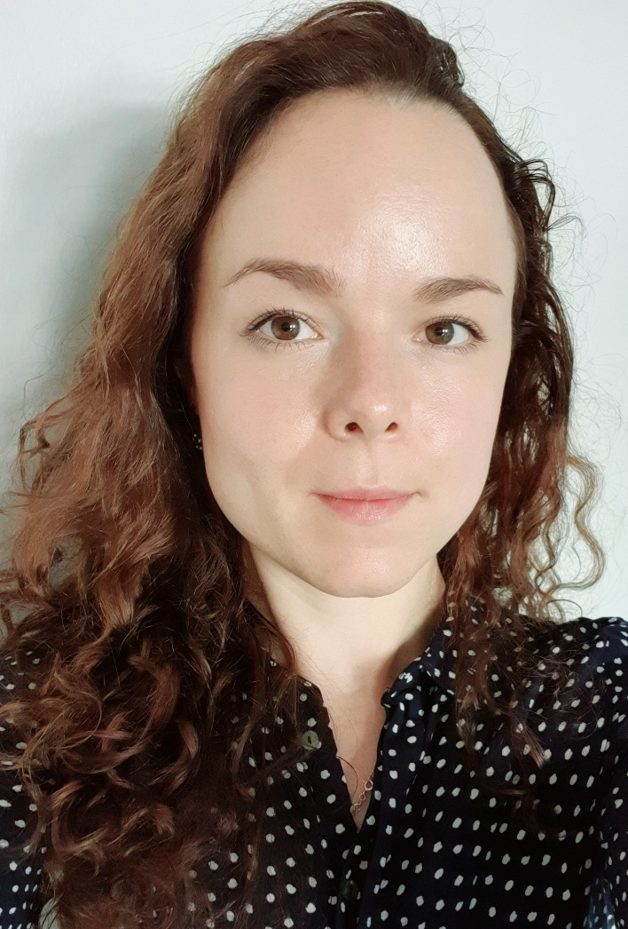
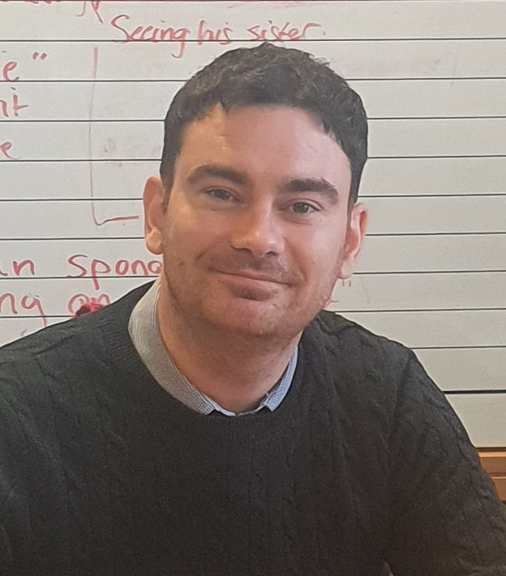
Link to Bearsden English Blog
Play me for an audio message from:
Miss Bartlett
&
Mr Breen

