Slide 1
Bearsden Academy
Parent/Carer Workshop: Supporting Teams

Slide 2
Welcome
Welcome to our Parent/Carer workshop on using Teams. We hope you find it useful in supporting your son/daughter at home.
We hope by the end of this session that you have a greater understanding of navigating Teams and an understanding of home learning.
We have a glow form that you can access anytime should you have any questions/issues. Click this link to access https://forms.office.com/Pages/ResponsePage.aspx?id=oyzTzM4Wj0KVQTctawUZKSl4pkU8_lVDomSbI4nDMqFUN1laWDRKRTI4RUdIU1FGWkZKUVEwTTlPUS4u

Slide 3
Tips for supporting at home
Have your son/daughter’s timetable handy
Help them be organised (pen, pencil paper, calculator, ruler etc)
Breaks and lunch are important
Ask them questions (What subjects do you have today? What did you do today?)

Slide 4
What is Home Learning?
Our main platform is Teams.
Each year group and subject have their own Team and young people have been added to their subjects.
Class teacher, Principal Teacher, Guidance and Year Head are also added to each Team.
Young people are encouraged to follow their school timetable.
Young people will experience a suite of lesson content.

Slide 5
When you log in to teams, you will see options down the side.
Each of your teams will be assigned their own individual box.
You click on these to access them.

Slide 6
When you click on the team, it opens up to show content contained.
Each subject has their own channel, and this is where to find the class work.

Slide 7
When you click a subject, it will show you recent posts about the lesson
Taskbar along the top
You can click reply if you have any questions

Slide 8
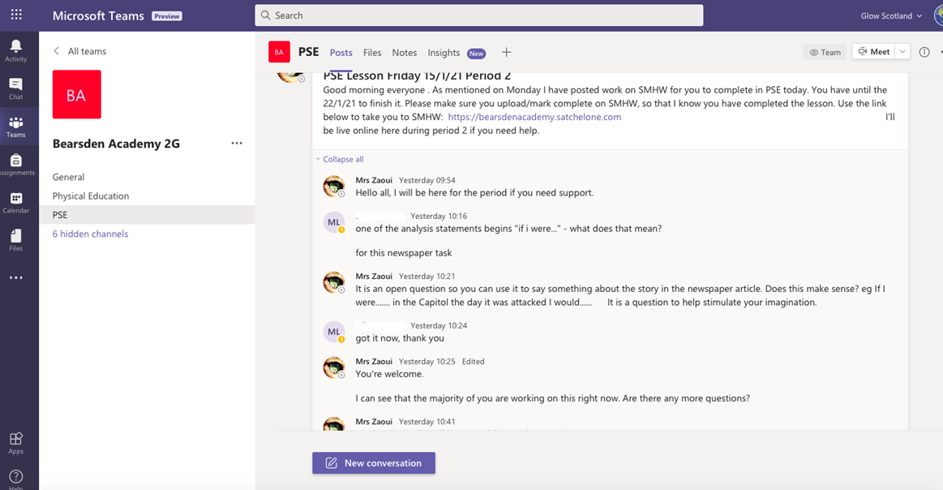
Pupils can ask questions if they hit ‘reply’.
Teachers are online to answer questions

Slide 9
If you click on Files, it shows you documents that have been uploaded.

Slide 10
Pupils can see a list of assignments by clicking here
Subjects can upload assignments for young people to complete.

Slide 11
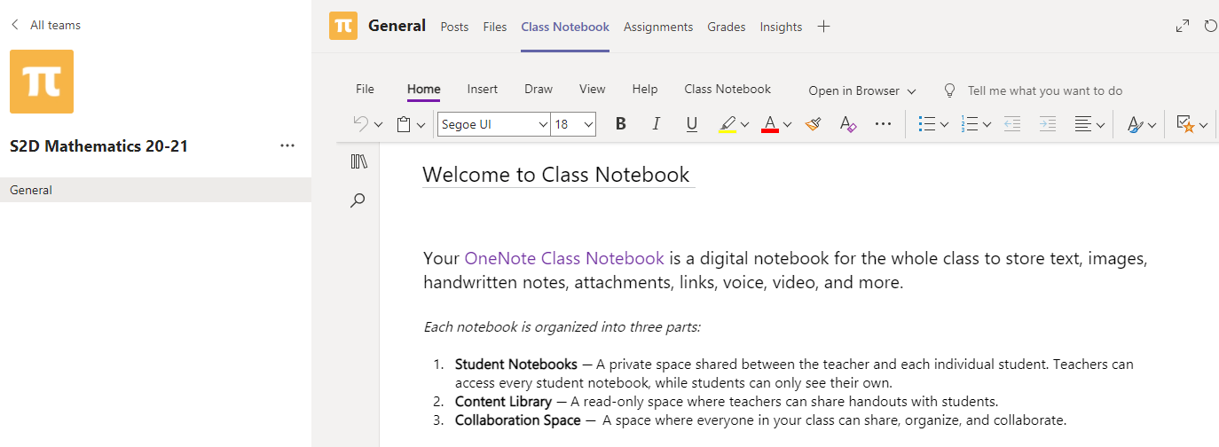
Class Notebook allows you to upload work.
You can always email your child’s Guidance teacher or Year Head. Happy to help.

Slide 12
Top Tip
Think of Teams like a new phone. It takes you a while to work it (old age?). Practice makes perfect

Slide 13
Where can I find other support?
Our school website has a lot of useful information. Click the link to access http://www.bearsdenacademy.e-dunbarton.sch.uk/learning/home-learning/
You can also contact your child’s guidance teacher or year head.

