Slide 1

Bearsden Academy
Parent/Carer Workshop: Supporting Your Son/Daughter with home learning

Slide 2

Welcome
Welcome to our Parent/Carer workshop on tips and ideas on how you can support your child with home learning. We hope you find it useful in supporting your son/daughter at home.
Please see the link to workshop deliver yesterday which is now available on the website http://www.bearsdenacademy.e-dunbarton.sch.uk/parents-info/parental-workshops/

Slide 3
How can I support my child with home learning?
Parents and carers can support their child with learning from home by:
Encourage your child to actively participate in their online learning activities
supporting your child to follow their normal timetable where possible
supporting your child to engage in any scheduled interactions by their teachers
communicating any concerns with your child’s learning at home to their Guidance teacher
Reassure them
Help them find their study style
Make sure the rest and exercise

Slide 4
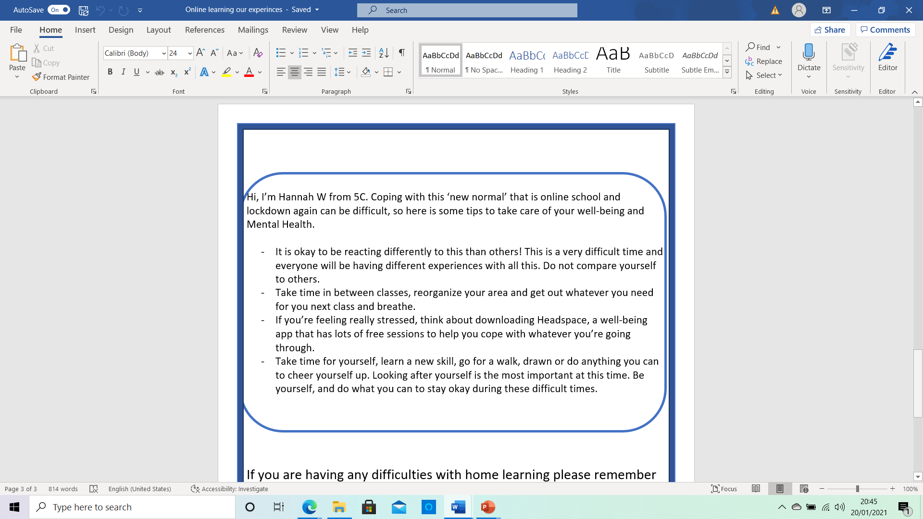
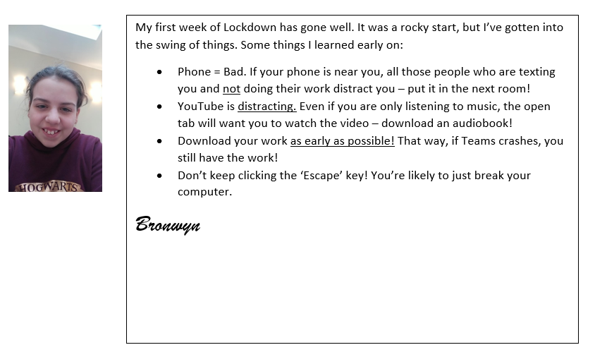
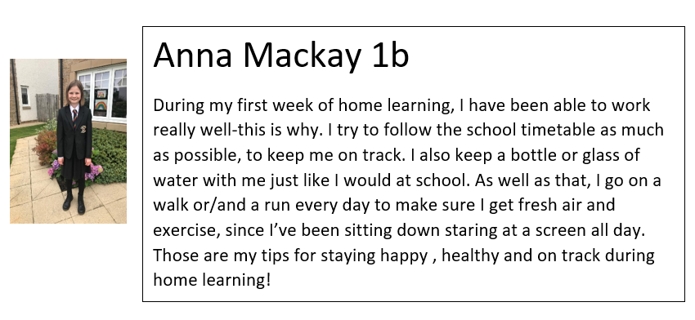
Advice from our pupils after 1 week to each other

Slide 5
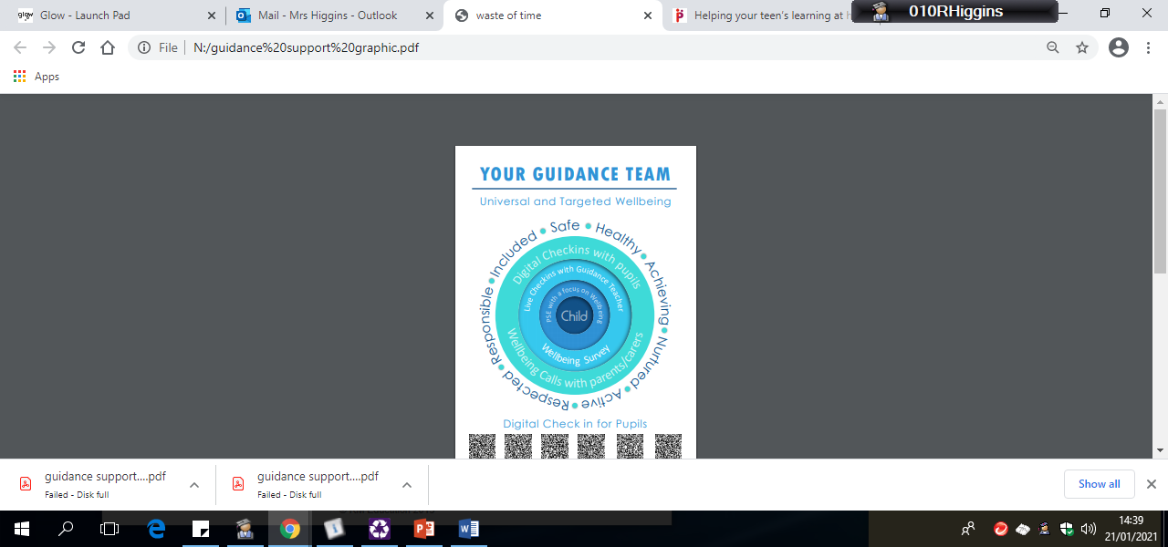
Wellbeing Support

Slide 6
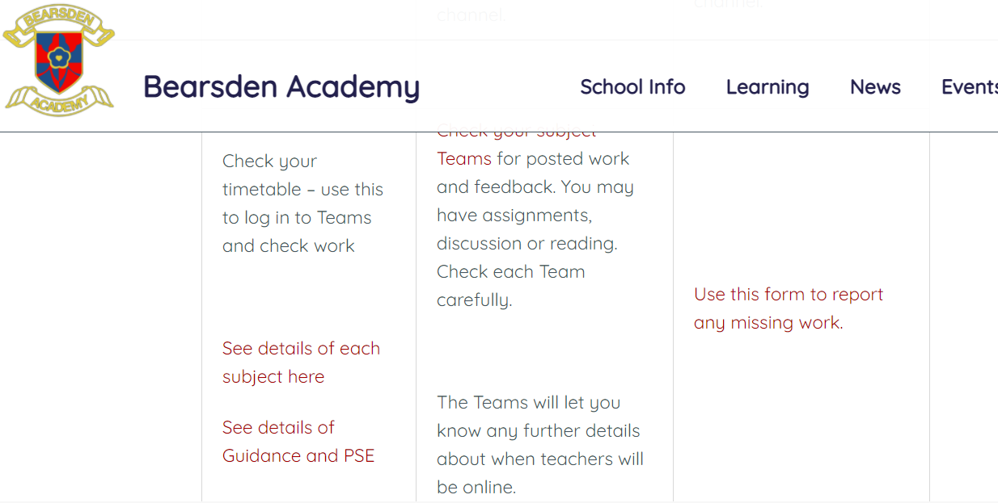
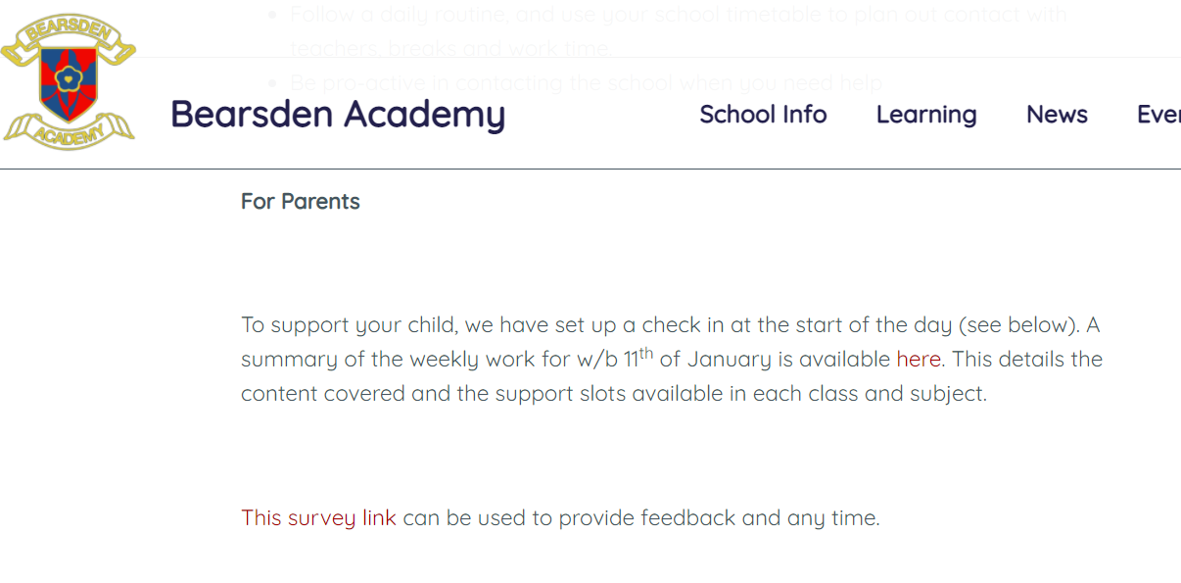
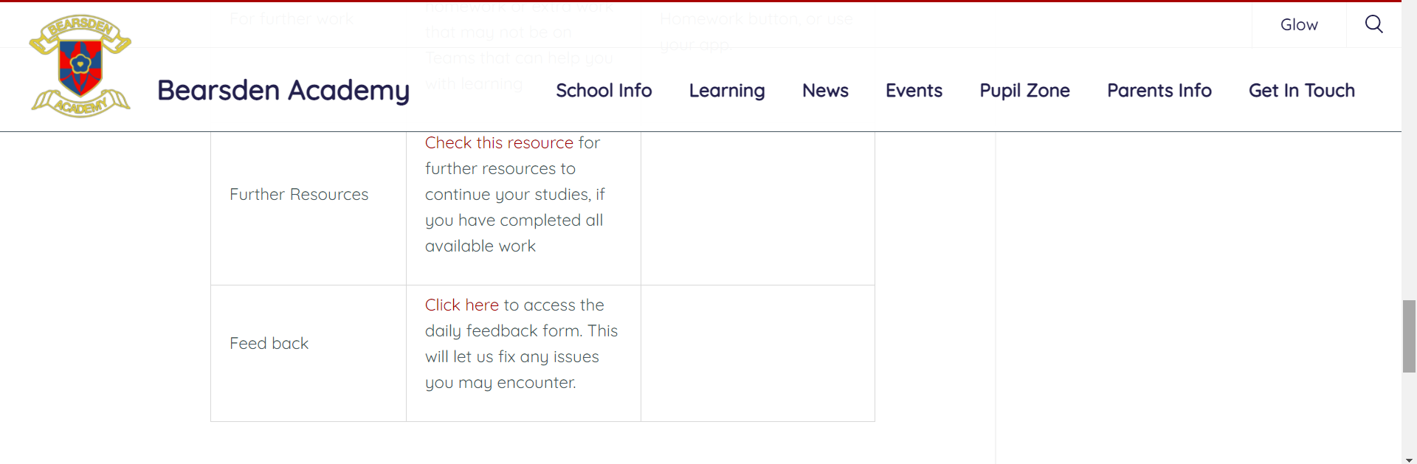
How can both my child and I give feedback?

Slide 7
Where can I find other support?
Our school website has a lot of useful information. Click the link to access http://www.bearsdenacademy.e-dunbarton.sch.uk/learning/home-learning/
You can also contact your child’s guidance teacher or year head.

Slide 8
FAQ Section
Parental Question

Slide 9
Why do some subject teachers offer live classes and some don't, is it compulsory to offer live learning? What is the rationale for live lessons not being compulsory?
Live lessons are not compulsory – they are a teaching tool that may be effective for deliver in some contexts. Within Bearsden Academy live lessons are taking place across all year groups. Your child’s teacher is best placed to determine what learning will look like for their subject and level. Learning experiences will therefore vary depend upon the course and staff member.
It is important that pupils have time for independent work and reflection. The school has shared advice with teachers on following national research (see the Education Endowment Foundation’s website). This encourages five stages of learning online:
Activate: What we learn depends on what we know already, and it’s important to get students thinking about prior knowledge that will help them with their next steps.
Explain: An integral aspect of any learning sequence will be explanations. A powerful way of doing this is to model thinking, by focusing on the thought processes behind decisions you make, as well as teaching the strategy itself.
Practice: Our ultimate aim is that our pupils will be able to work independently, but they will need sufficient scaffolding and guidance to get there.
Reflect: An important aspect of self-regulation is reflecting on what you have done and using this to inform what you’ll do in future.
Review: Reviewing previous work, and retrieving key ideas from memory, aids long-term retention, particularly if this happens once you’ve started to forget what you’ve learned.

Slide 10
How can I best support my daughter when I am not knowledgeable in the subject?
Education Scotland has advice on supporting home learning here.
Further advice from Parent Club is available here.
The collection of Scottish Government and Education Scotland advice is here.
If you are looking for additional resources or materials please see the suggestions below:
E-Sgoil is a national resource which is available for all pupils and provides daily learning experiences to complement our own remote learning plans during lockdown. You can find details of the live daytime and early evening sessions which they offer using the links below.
Daytime Study Support: http://e-sgoil.com/daytimestudysupport2020/
Early Evening Study Support: http://e-sgoil.com/daytimestudysupport2020/
To access these sessions, pupils need to register using their Glow account.
In additional your child can also access Scholar.
Pupils studying National 5, Higher or Advanced Higher in the subjects outlined below can access Scholar. This is an online programme created with Heriot-Watt University that provides integrated materials, activities, assessments and revision packs. Your child may already be using this resource in their class. Scholar is available in the following subjects – Biology, Chemistry, Physics, Computing Science, Maths, Art and Design, Business Management, Psychology, English, French, German, Spanish and Mandarin.
The BBC offers national subject content via Bitesize and Lockdown Learning.

Slide 11
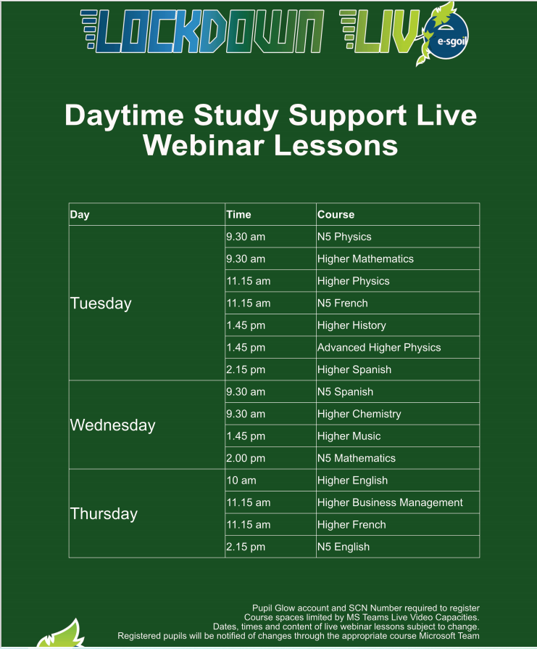
Digital learning from Comhairle Nan Eilean Siar | e-Sgoil (e-sgoil.com)
Additional useful websites
for subjects have been
added to the end of the
powerpoint.

Slide 12
How much time is reasonable for them to be spending on school work per day?
We are expecting pupils as far as is possible and reasonable to follow their normal timetable at home. We are keen to sustain and progress their learning. However, we are acutely aware that families need flexibility and that remote learning 8.50am – 3.05/3.55pm may not be possible, or indeed, desirable for many young people.

Slide 13
How are the teachers giving feedback to students after they complete each piece of work?
Feedback will be given in a variety of formats, based on the learning taking place.
Assignments in Teams will be used to provide feedback during and after a session. In each Team a pupil will be able to see their logged marked under assignments.
Teachers may also give feedback by returning work to pupils in other ways, depending on the work. Within Teams, teachers can use a Class Notebook, which allows teachers to give written feedback on the work submitted.
If it is unclear to pupils what feedback is being provided, they should speak to the teacher. Feedback is an important part of the cycle of work – we are keen to ensure pupils are aware of all feedback.
We are looking at best ways to measure and report engagement. Pupils who are not engaging consistently will be flagged to Guidance teachers and Year Heads. We will contact parents when a concern arises.

Slide 14
Do all assignments appear under the assignments section?
Why do only some lessons appear in the calendar?
Assignments set within Teams will appear in the Assignments section.
Teachers use assignments to set deadlines for work. Pupils will be able to see this for all set assignments.
Where an assignment is not present in this list, teachers will give an explanation of what is expected within the Teams channel. This may be focused on discussion within the channel or updates to notes over time. Feedback should be available to pupils within the Team.
Online lessons that are live meetings using Teams meet will appear in the calendar when scheduled. Most teachers will schedule these meeting in advance of the session, however, they may also “go live” during a period in response to pupil requests – these would not appear in the calendar. Teachers are advised to set up Teams meetings in advance and we will continue to work on the best way of sharing this information.

Slide 15
Why are teachers not using the same process for issuing work?
Most teachers and departments will use assignments as the main tool to ask for and retrieve work
In some case, there may be tools more suited to the work being carried out. Pupils will have been given time to familiarise themselves with these tools beforehand.

Slide 16

Thank you for attending tonight's session
We hope you have found it useful.

Slide 17
Wellbeing Support
Wellbeing Support Advice
Have the conversation and offer reassurance
Continuing the conversation around Covid-19 can be very difficult, but it is important to provide young people with an opportunity to express their thoughts and feelings around this as well as ask questions. During this unpredictable time it is important to remember that offloading their worries and offering reassurance may be enough. However, if they are looking for your help and advice to cope with the situation remember to be realistic and optimistic.
Provide accurate information
It is so important that you offer factual information to young people whilst monitoring their access to social media and broadcasting news in order to ensure that they do not become overwhelmed. To be clear providing factual information is helpful, but adjusting the amount and detail to match their age is crucial. The NHS provides updated, accurate information at https://www.nhsinform.scot/
Focus on strengths and support of others
Focus on your own and your child’s strengths to get through this time, and remind them of the many strengths they have to help them cope when they feel worried.

Slide 18
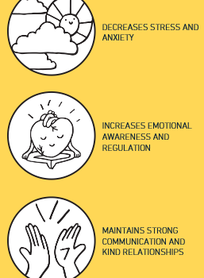
Wellbeing Support
Try to follow a routine
Try to continue with whatever normal family routines that you can.
Practice mindfulness
Use websites to facilitate mindfulness and positive changes. This app is directly aimed at teenagers and young adults. It allows for a simple ‘check in’ and then generates personalised guided exercises, guided journaling and other helpful support to navigate challenges with resiliency and calm.
My Life/Stop, breathe and think has proven to achieve the following outcomes:
Download the app by following this link: https:/my.life

Slide 19
Wellbeing Support
Look after yourself and stay connected
This is a difficult time and we all cope with stressful times in a variety of different ways. It is important to make sure you look after your own health and wellbeing so that you can continue to support your child and others who rely on you. This means keeping a routine yourself, maintaining verbal and virtual contact with friends and family, exercising and ensuring health eating and drinking habits continue.
Although it can be helpful to keep up-to-date with official guidance and information surrounding Covid-19, try to limit the exposure you all have; this can increase worry.
Instead, look for positive and accurate on-line messages and supports, for example
https://www.actionforhappiness.org/ provides helpful calendars and clear positive advice.

Slide 20

Useful website to support home learning

Slide 21
Useful websites - Health & Wellbeing
GoNoodle
Health for Kids
Food Fact of Life
BBC Food Recipes
Food Techniques
Shout Support in a Crisis
Breathing Space
Childline
PE Home Learning Challenges

Slide 22
Useful website – Literacy and Numeracy
Literacy & English First Minister's Reading Challenge Literacy Trust Printing Press Puffin Schools ​World Book Day Roahld Dahl Kate Messner Newsround The Guardian Independent Herald Scotland 5 Minute English | Numeracy & Maths Sumdog Mental Maths Games Cool Maths Games Nrich Maths The Daily Rigour Corbett Maths Maths Revision Khan Academy

Slide 23
Computing Science Hour of Code Scratch Code Combat Blocky Games Coding Park Tynker Codecademy​ Seneca Learning Teach Computer Science Revision Room Higher Computing Science​ | Music​​BBC Teach ​﻿Muscial Futures﻿ Musipedia SFSKids Classics For Kids Free DJ Mixing Software Word Synth by Google Rythym Trainer Musical Mysteries Music Tech Teacher Music Technology Websites
Business Management Tutor 2 U Idea Biz Kids Digital Skills Administration & IT Brightred Books GCF Global​ Teach ICT ​Idea
ArtTate Kids Art & Design Activities National Galleries Google Arts & Culture MoMA Learning | SpanishLinguascope [click here to request login details] Languagesonline​ Duolingo
Science​Glasgow Science Centre Institute of Physics Nasa Science Programmes STEM Glasgow Edheads Exploratorium Science Kids ​ | Social SubjectsNational Geographic Worlds Largest Lesson ​ Scottish Parliament Weather Activities UN Natural Disasters 3D Geography Europe Puzzle Geography Games

Slide 24
General useful website
Bitesize​
BBC Teach
Twinkl Home Learning Hub
BrainPOP​
Kahoot
Gridclub
Scholastic
Scotland's Enterprising Schools​​

