Slide 1
Maths and Numeracy
Parental Workshop 2019

Slide 2

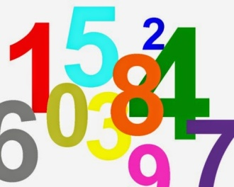
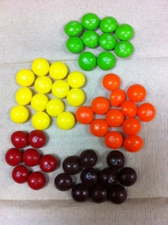
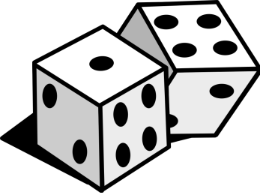
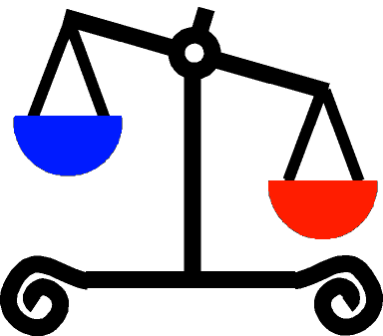
Counting – Forward Number Word Sequence (FNWS)
Counting – Backward Number Word Sequence (BNWS)
Counting objects accurately
Finger patterns and bunny ears *
Recognising dot patterns *
Recognising numerals and ordering them
Ways to help at home –
Numeracy and maths in everyday life
Home Link Bags

Slide 3

Finger Patterns
What are finger patterns?
They support the development of more sophisticated arithmetical strategies.
Moving fingers correctly as sing numbers rhymes
Finger patterns 1 to 5 on each hand, initially seen and then not (bunny ears).
Then 6 to 10
Doubles, number bonds to 10

Slide 4
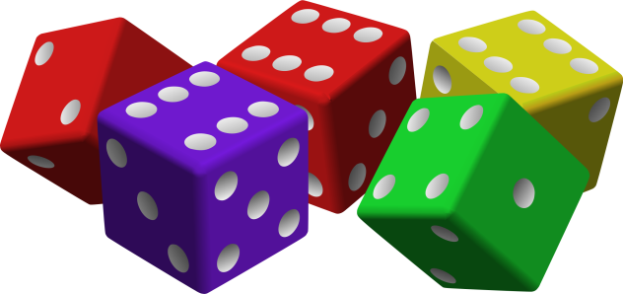
Recognising Dot Patterns
Subitising – ascribing numerosity to collection of items, typically a spatial configuration of dots, immediately and without counting.
Regular dot patterns, irregular dot patterns
Activities using spatial patterns are very useful in helping young children to understand how numbers can be made up and also broken up.

Slide 5
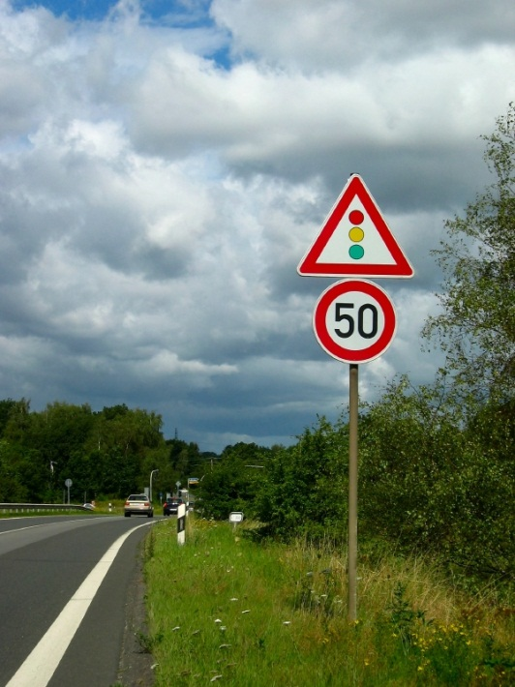
Ideas of things to try
Count objects in daily life e.g. stairs,
cars, cups, cutlery, shoes etc.
Look for numbers around you
e.g. numbers on buses, road signs,
house numbers, car registrations,
birthday cards etc.
Count forwards and backwards, say number rhymes, play blast off
Use first, second, third when describing order

Slide 6
Ideas of things to try continued…
Get your child to help put out the recycling, talk about the shapes and sizes of objects and sort them
When sorting the washing pair socks, compare the sizes of family members clothes, sort the clothes by who they belong to
Look at patterns on clothes
Sort the clothes by colour, size, type

Slide 7

Ideas of things to try continued…
Let your child fill and empty different sized tubs, cups and bottles at bath time
Bake with your child, let them help you with weighing and measuring
Look at the shape, size and numbers on coins
Let your child pay for items in the shops

Slide 8
Ideas of things to try continued…
Through your family routines talk about time, today, yesterday, tomorrow and the days of the week
Count how many sleeps to birthdays, Christmas and other important events for your child
Talk about the changes in the seasons
by looking at how the environment
changes over a year

Slide 9
Home Link Bags
Ten bags covering a range of areas of maths, all bags have a number story book inside
Recognising and Ordering Numbers
Size Order
Sorting
Dot pattern games
Snap - matching
Pattern
Dominoes

