Slide 1
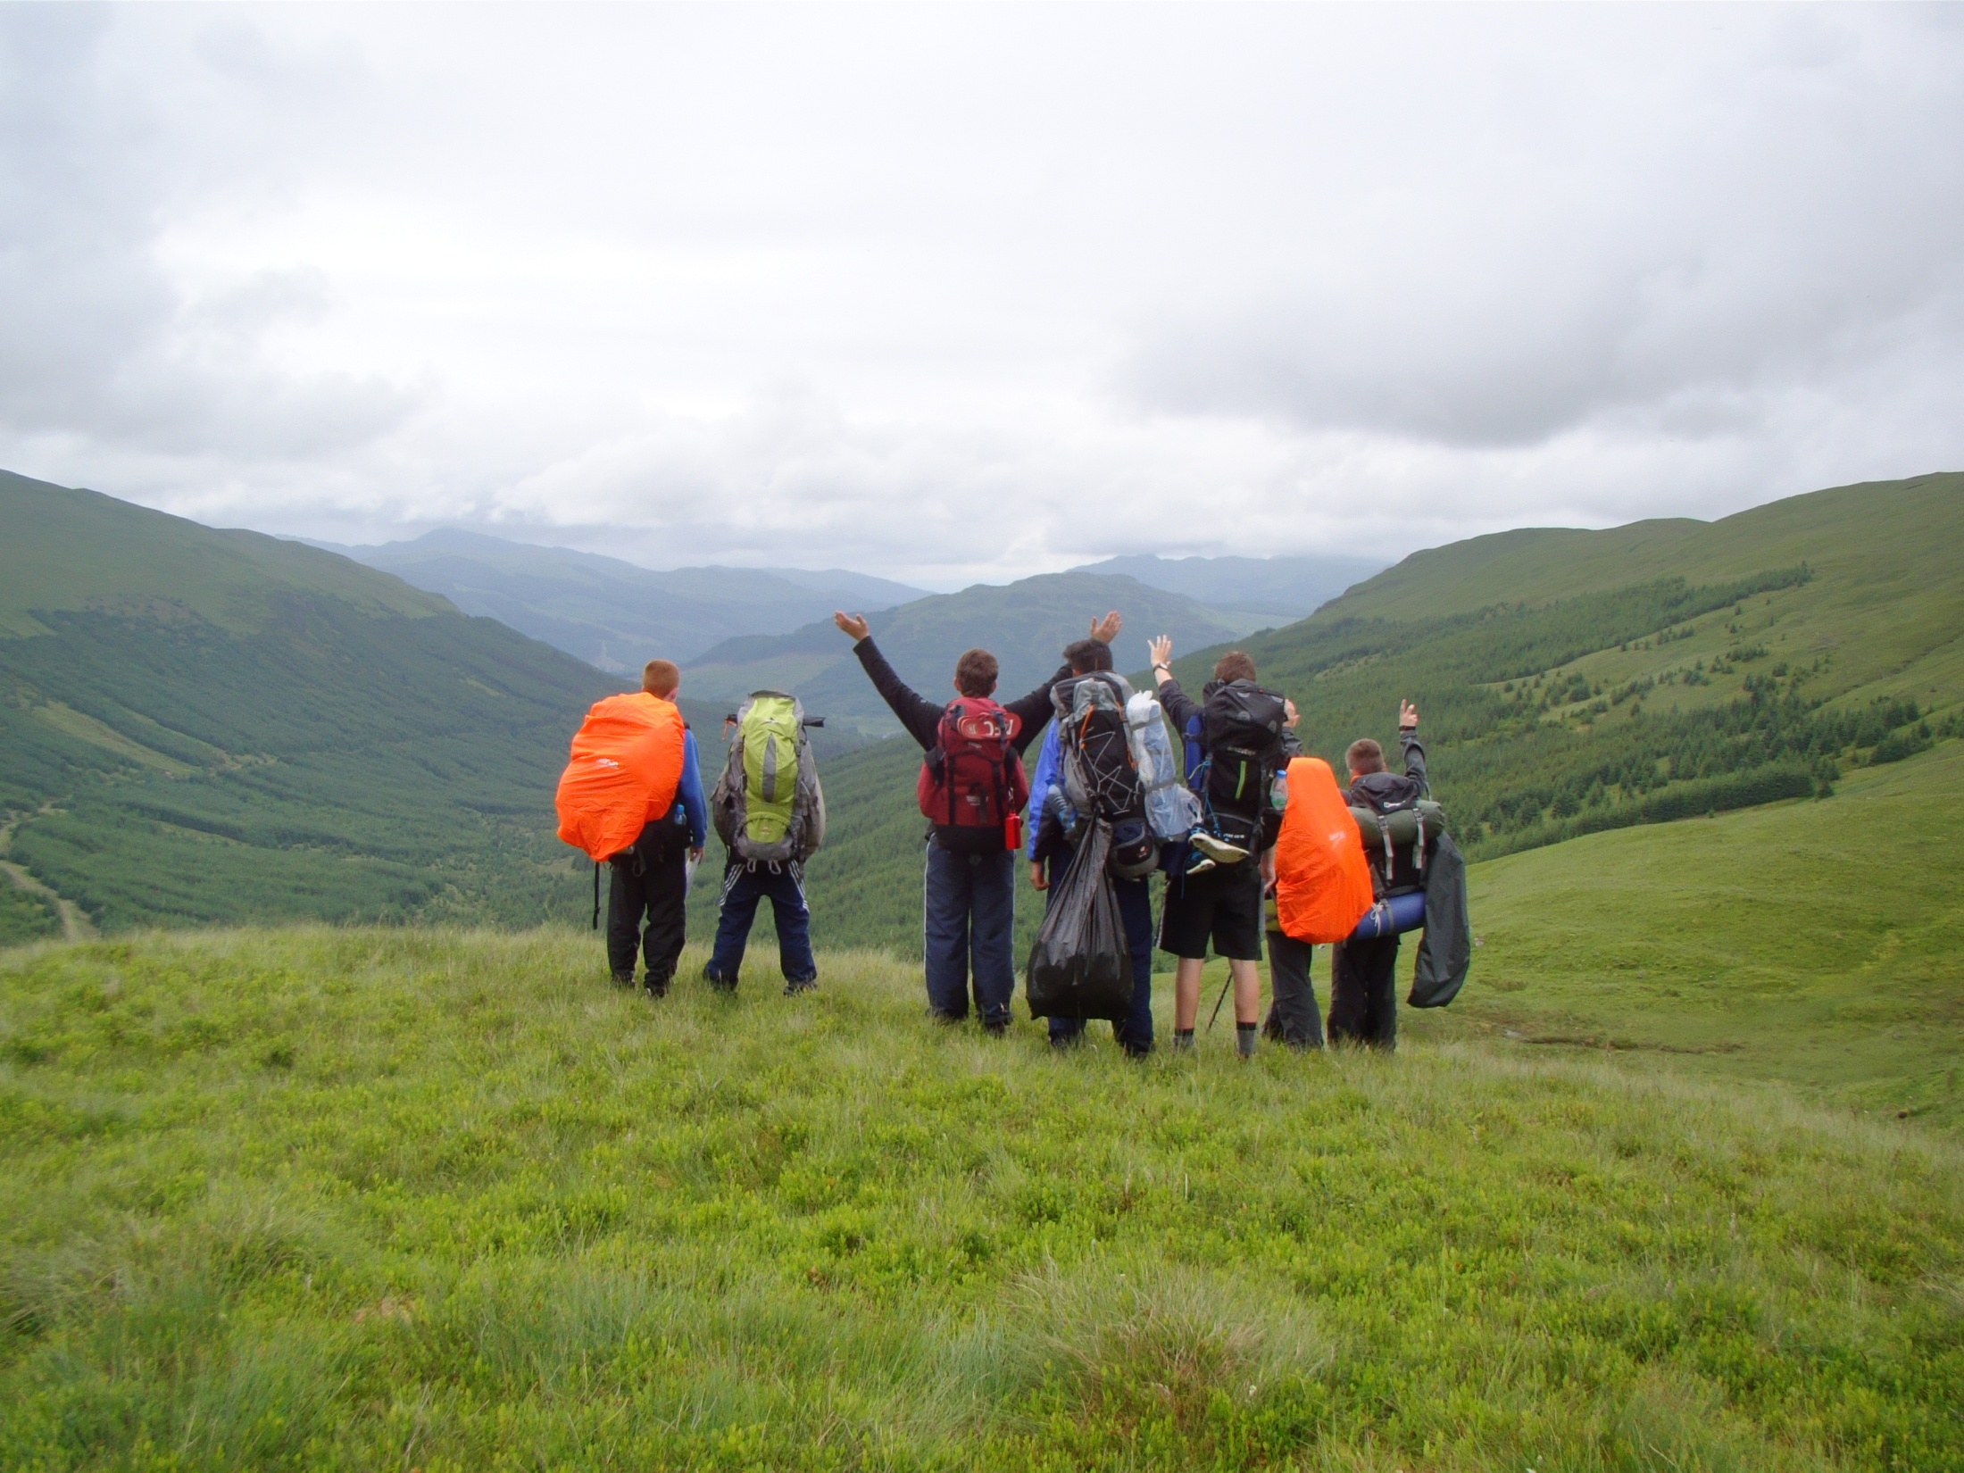

Bearsden Academy
September 2019
Notes:
Welcome,
Check to see if any of the DofE Managers are coming for the first time.
Check Agenda – anything to add take away
Any Domestic arrangements etc.

Slide 2

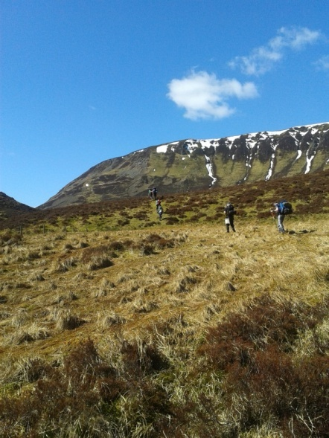
What is the D of E Award?
It gives young people the chance to develop skills for work and life, fulfil their potential and have a brighter future.
3 levels of Award:
  - Bronze, Silver and Gold
4 sections to complete:
  - Volunteering
  - Physical
  - Skills
  - Expedition

Slide 3

Numbers of places
Bronze Award places (S3):
6/8 walking groups with 7 pupils in each group = 42/56 pupils
Silver Award places (S4):
  5 walking groups with 7 pupils in each group = 35 pupils
  provisionally 3 Canoe groups with 8 pupils in each group
  = 24 pupils
Total = 102/116 pupils from S3/4

Slide 4
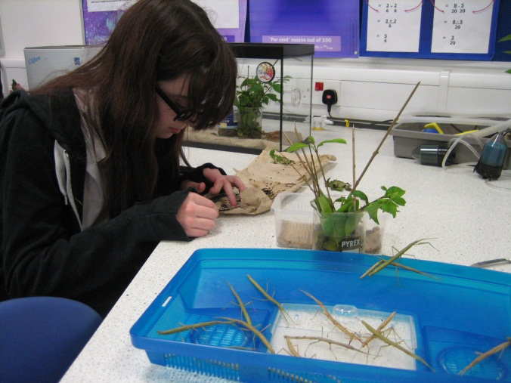
Timescales for sections
Each activity must be done for a minimum of 1 hour per week and for a set number of months.
Bronze Award (S3):
  Volunteering – 3 (or 6) months
  Physical – 3 (or 6) months
  Skill – 3 (or 6) months
  - 2 expeditions – 2 day/1 night
Silver Award from Bronze (S4):
  Volunteering – 6 months
  Physical – 3 (or 6) months
  Skill – 3 (or 6) months
  - 2 expeditions – 3 day/2 nights

Slide 5
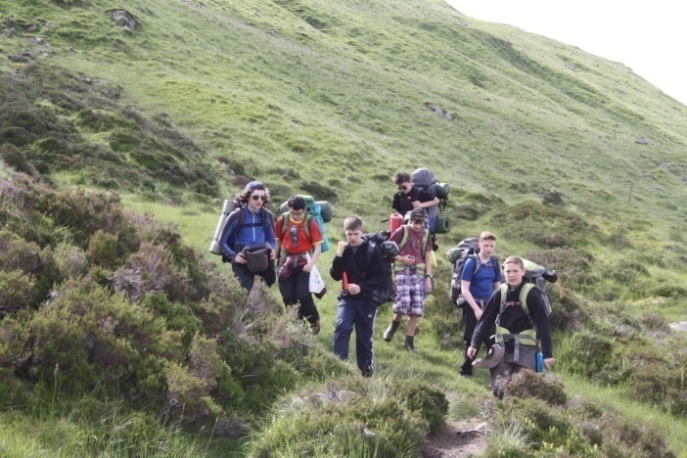
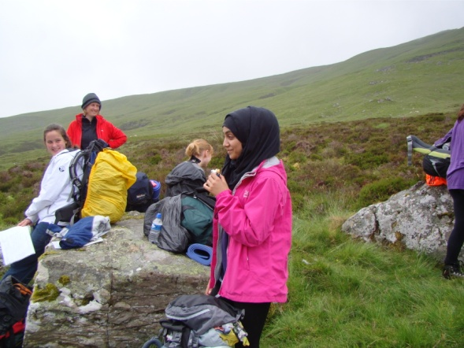
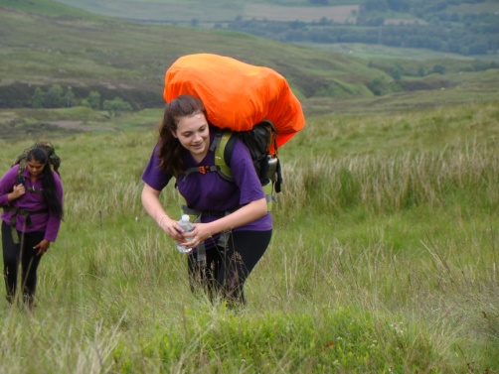
Timescales for sections
Silver Award direct entrant (S4):
  Volunteering for 6 months
  Physical/Skills ---one section for 6 months, the other for 3 months
  A further 6 months on volunteering or the longer session above
  2 expeditions – 3 days/2 nights
Pupils will organise and complete their Volunteering, Physical and Skills sections in their own time out with school, and the Expedition section will be organised within school.

Slide 6
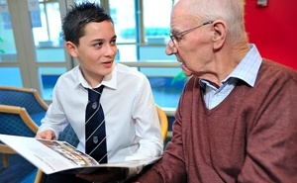


Volunteering
This is about making a difference to peoples lives.
Charitable status
  Helping others e.g. helping older people.
  Community Action and raising
  awareness e.g. campaigning,
  council representation.
  Working with the environment or
  animals e.g. litter picking.
  Helping a charity or community
  organisation e.g. working in a charity shop.
  Coaching, teaching and leadership e.g.
  sports leader, Brownie leader.

Slide 7
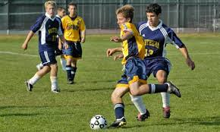
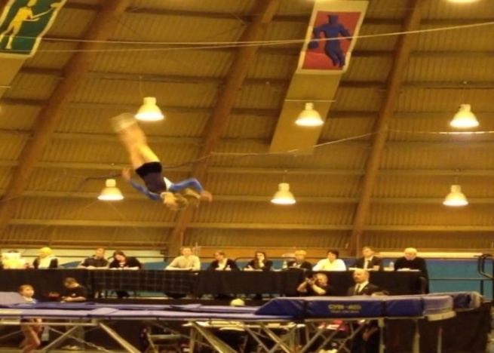
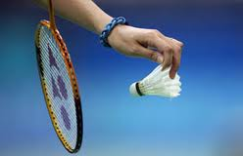
Physical
You should achieve great physical fitness through participation and improvement in physical activity
  Hot and sweaty!
  Dance
  Martial Arts
  Extreme sports
  Team sports
  Individual sports
  Water sports
  Racquet sports
  Fitness

Slide 8
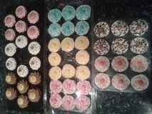
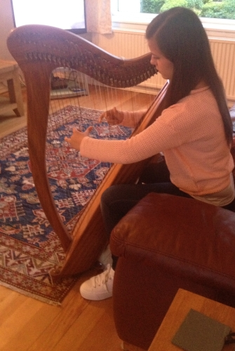
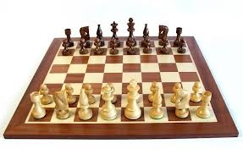
Skills
This is about developing practical and social skills and personal interests.
an activity that allows you to prove you have broadened your understanding and increased your expertise.
  Music
  Life skills
  Science and Technology
  Performance Arts
  Games and Sports
  Creative Arts
  Learning and Collecting
  Media and Communication
  Natural World

Slide 9
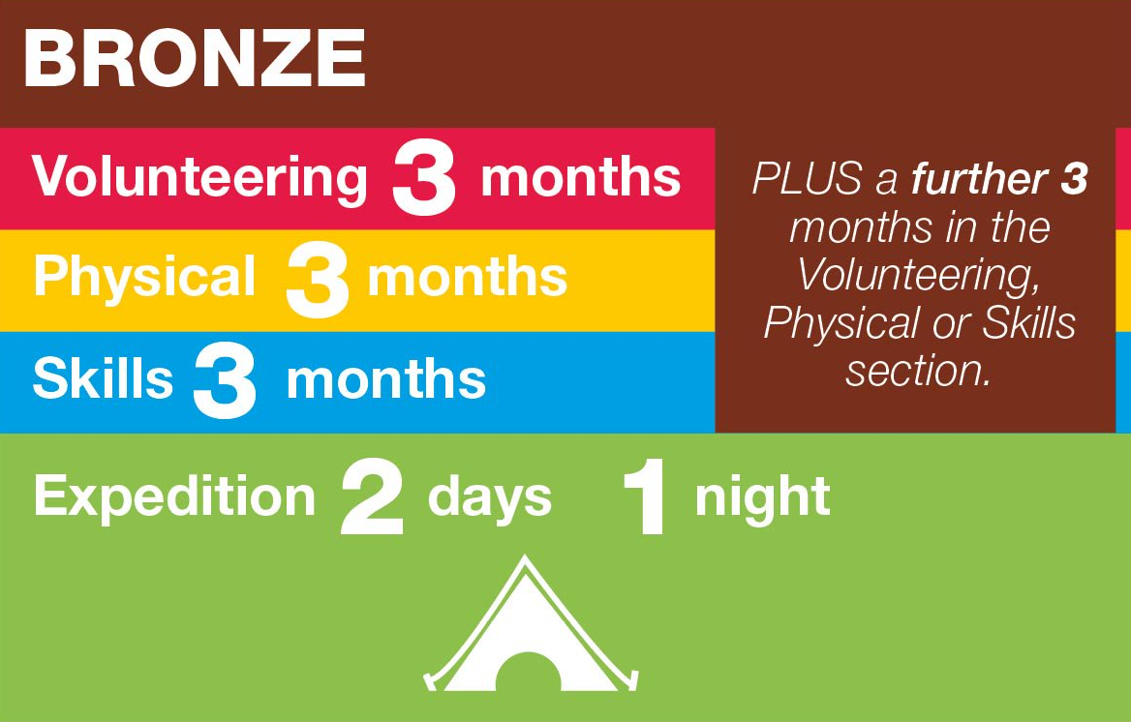
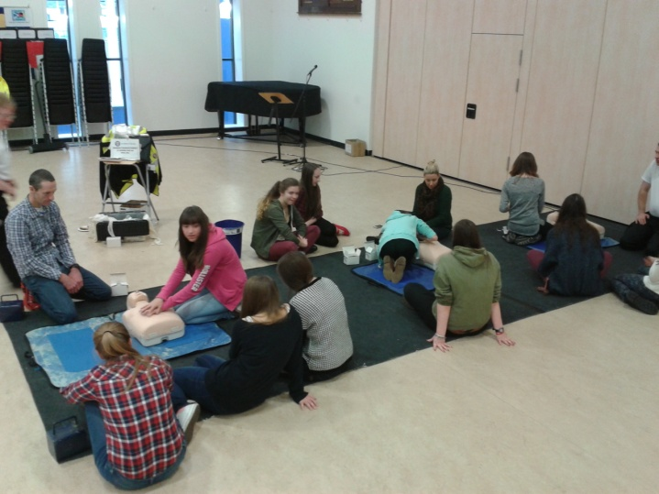
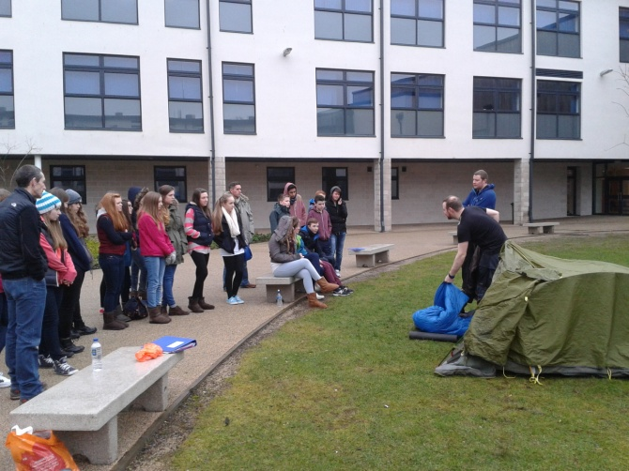
Duration of sections

Slide 10
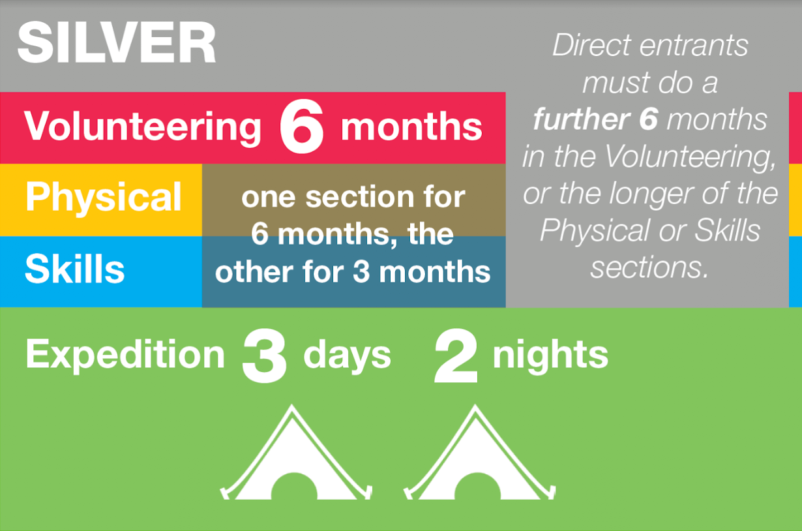
Duration of sections

Slide 11
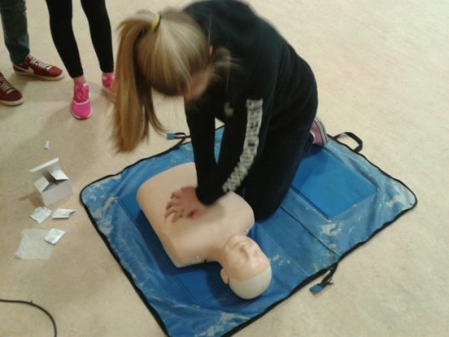
Expedition Training
Bronze Award:
  One Saturday (10am – 1pm) per month plus a day in Mugdock park (7 Saturdays).
Silver Award from Bronze:
  Walking groups - Four evenings in February and March.
  Canoe groups – Four evenings in February and March plus a weekend canoeing training in February/March.
Silver Award direct entrant:
Monthly training after school on Tuesday from 3 30 to 5 approx

Slide 12
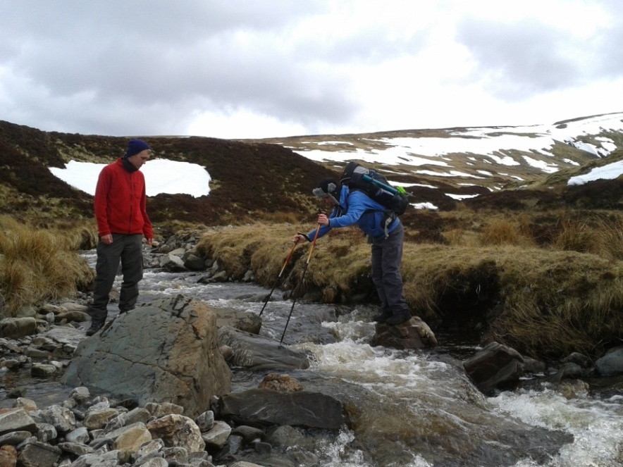
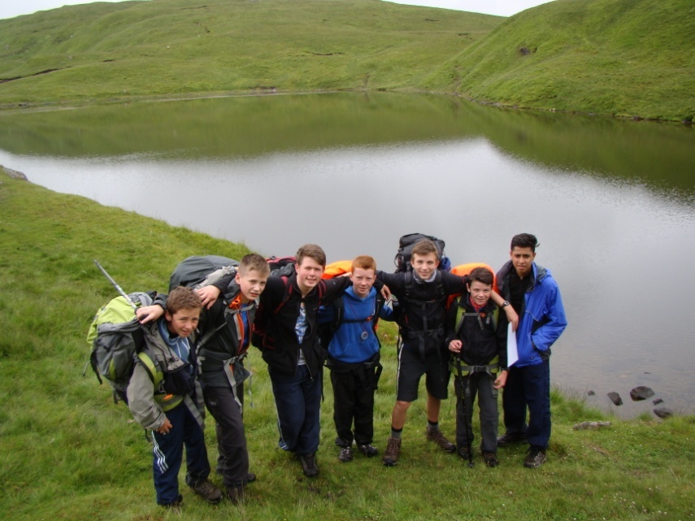
Expedition
Groups will plan a route with an aim for their expedition.
All groups carry out a practice expedition at the end of March, and a Qualifying expedition with an Assessor in May (Bronze) or June (Silver).
These expeditions are self-sufficient and remotely supervised.

Slide 13
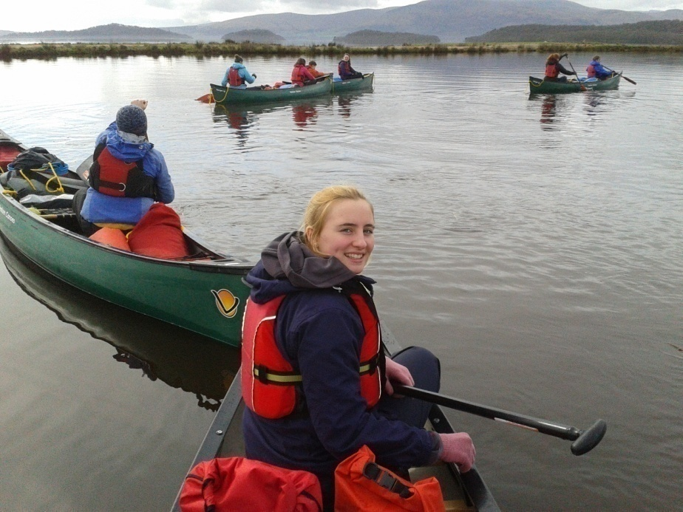
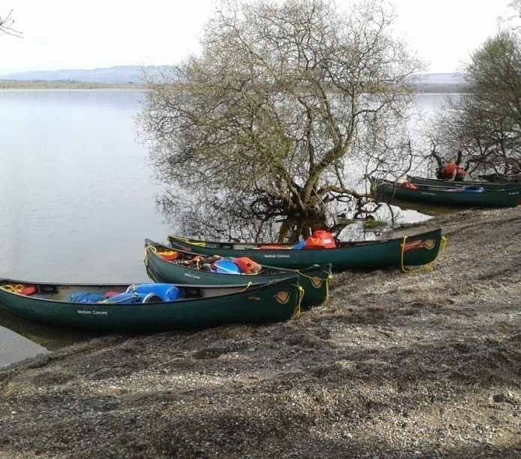
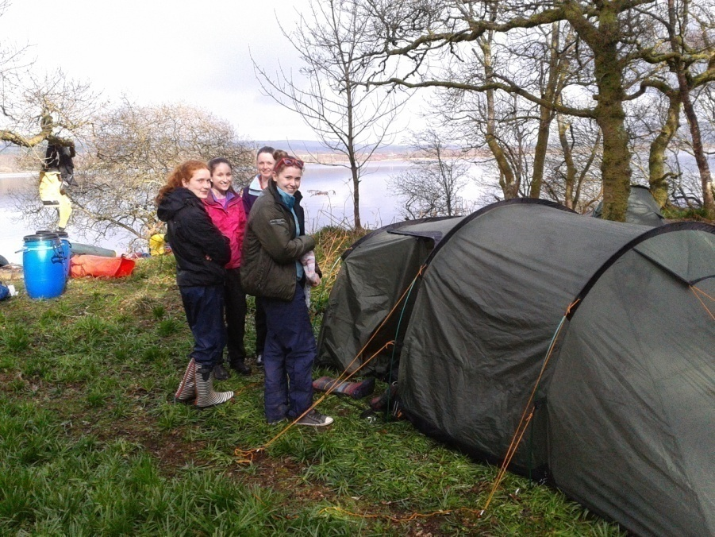
Canoeing Expeditions
Organised and supervised by Mr Alan Smith, East Dunbartonshire’s Outdoor Education Officer and his team. Training day in March, practice expedition in April, qualifying expedition in June.

Slide 14
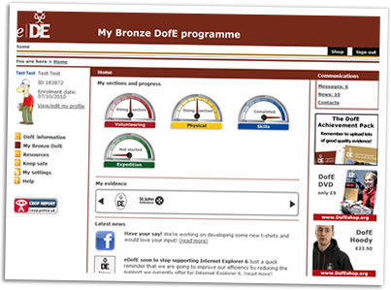
Completing the Award
Each of your sections are logged on www.edofe.org complete with evidence (photos/text etc).
Your D of E leader will sign-off your sections as you submit them.
A Expedition presentation is made and delivered with your group to parents and staff after your Qualifying expedition is completed (August 2019)

Slide 15
How to apply
Application forms available on Tuesday 11th on the table in the corridor outside DHT Offices
Pick up a yellow application form (S3 Bronze) or blue application form (S4)
Return the completed form to Mrs. MacKay in her office by Monday 16th September. If off ill then you/parent must contact the school stating you are applying by the deadline.
Full complete application forms will be selected. If there are more application forms than spaces , then participants will be selected by ballot

Slide 16
Cost
The likely cost for Bronze Award is £130
The likely cost for Silver Walking groups is £130
The likely cost for Silver Canoeing groups is around £300
In all cases the cost covers registration for the Award, transport, Assessor’s fees, supervisor’s fees (where necessary), equipment replacement, staff training (where necessary)

Slide 17


Parent helpers welcome
Saturday morning training sessions
Supervising expeditions
If interested,
speak to Mrs MacKay at the end

Slide 18
Possible Alternatives
Allander Open Award Centre (AOAC)
Meets in Milngavie on Wednesday evenings
There are spaces for all levels but we have no information on this yet. It is unlikely that they will be able to accommodate direct entrants.
Kirkintilloch Open Award Centre (KOAC)
Meets in - Hillhead, Kirkintilloch on Tuesday evenings.
Applications for all spaces via Alan Smith, EDC Outdoor Education Officer
  www.dofe.org

