Slide 1
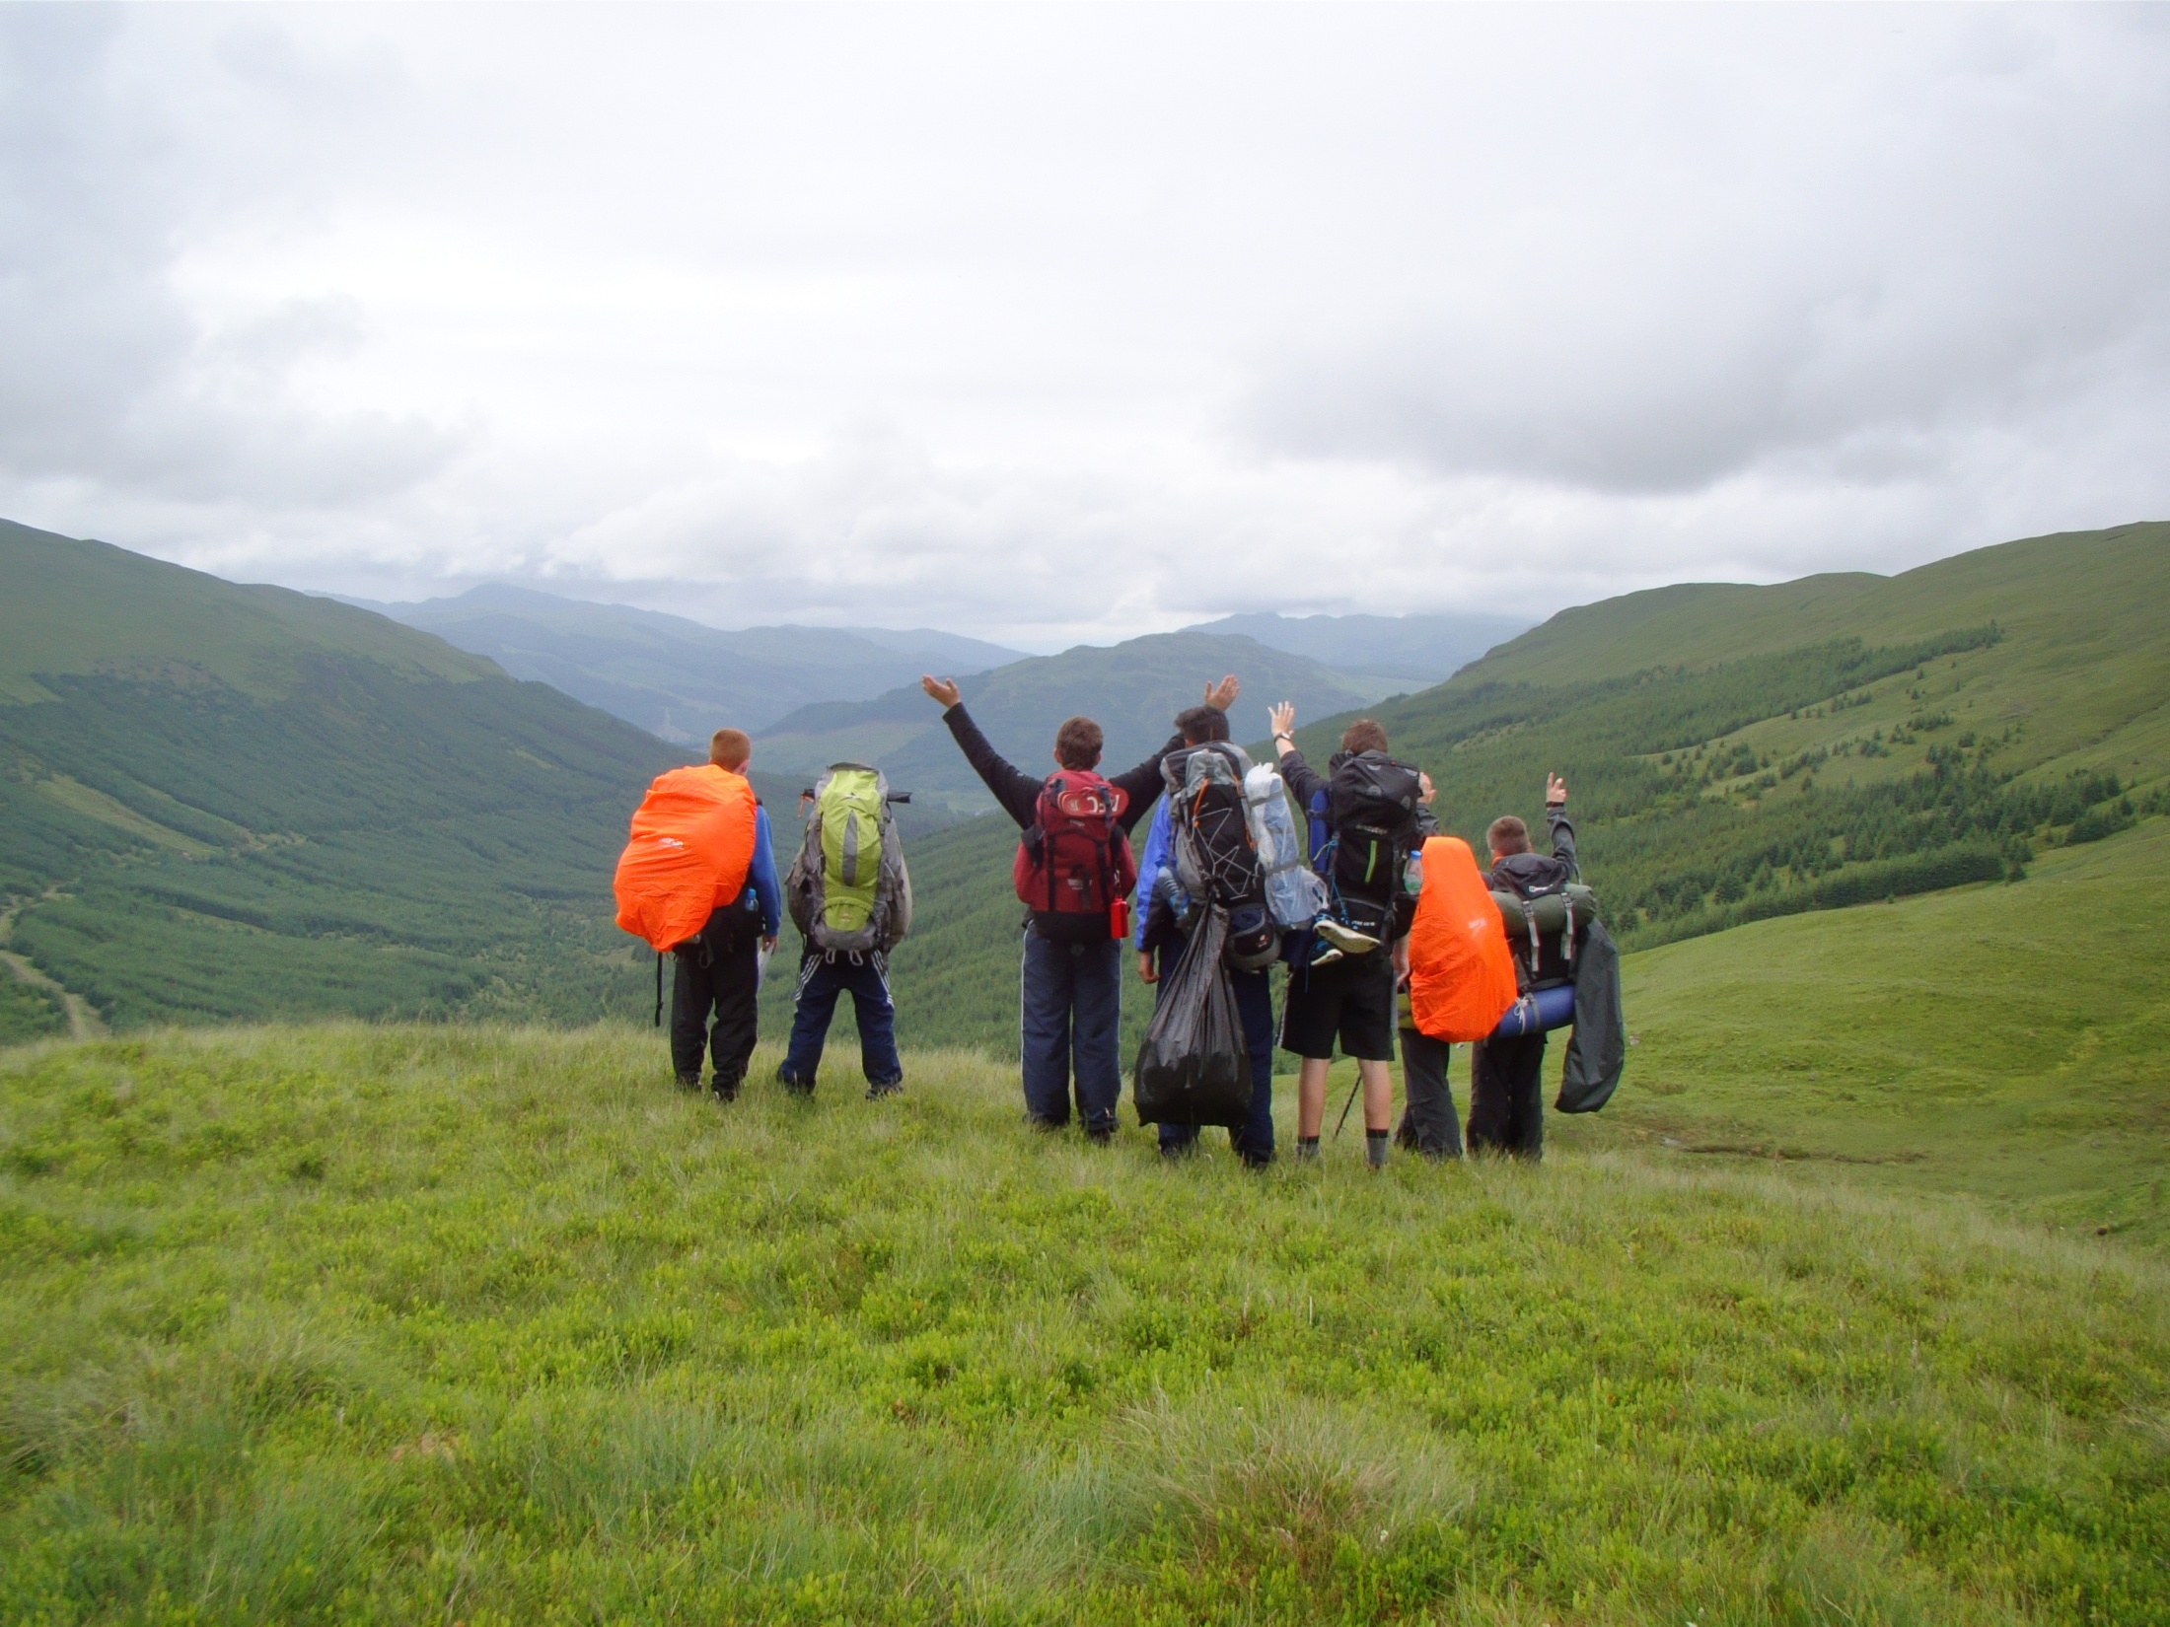

Bearsden Academy
September 2019
Notes:
Welcome,
Check to see if any of the DofE Managers are coming for the first time.
Check Agenda – anything to add take away
Any Domestic arrangements etc.

Slide 2

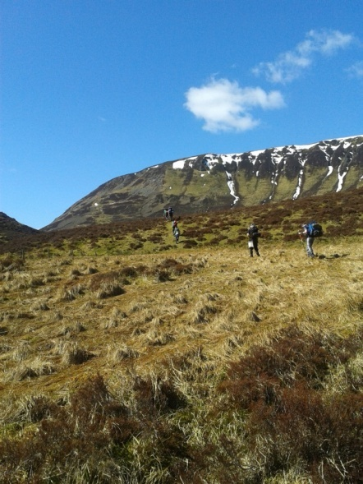
What is the D of E Award?
It gives you the chance to develop skills for work and life, fulfil your potential and have a brighter future.
3 levels of Award:
  - Bronze, Silver and Gold
4 sections to complete:
  - Volunteering
  - Physical
  - Skills
  - Expedition

Slide 3
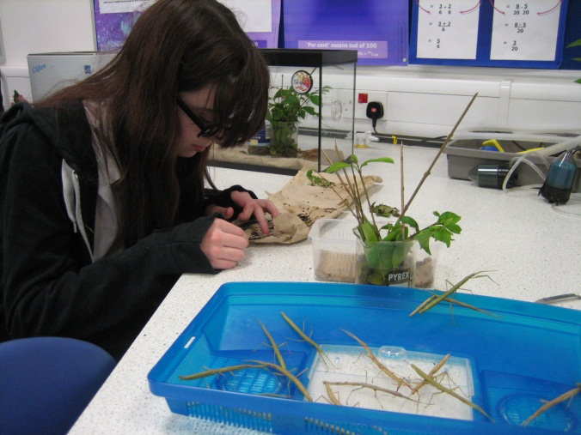
Timescales for sections
Each activity must be done for a minimum of 1 hour per week and for a set number of months.
Bronze Award (S3):
  Volunteering – 3 (or 6) months
  Physical – 3 (or 6) months
  Skill – 3 (or 6) months
  2 expeditions – 2 day/1 night
  Pupils will organise and complete their Volunteering, Physical and Skills sections in their own time out with school, and the Expedition section will be organised within school.

Slide 4
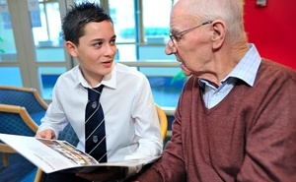


Volunteering
This is about making a difference to peoples lives.
Charitable status
  Helping others e.g. helping older people.
  Community Action and raising
  awareness e.g. campaigning,
  council representation.
  Working with the environment or
  animals e.g. litter picking.
  Helping a charity or community
  organisation e.g. working in a charity shop.
  Coaching, teaching and leadership e.g.
  sports leader, Brownie leader.

Slide 5
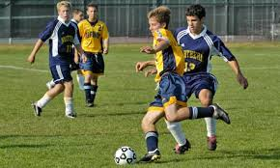
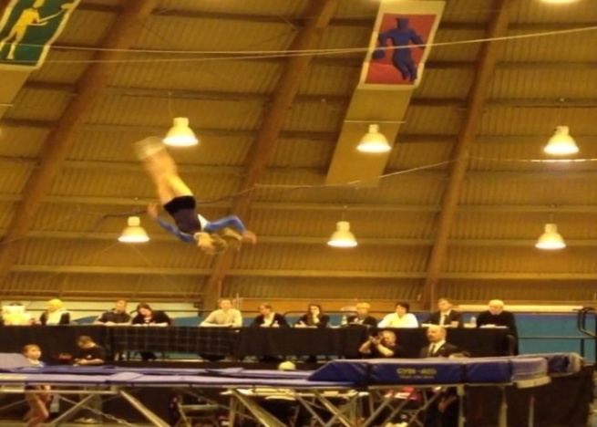
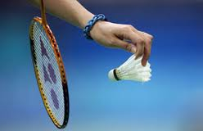
Physical
You should achieve great physical fitness through participation and improvement in physical activity
  Hot and sweaty!
  Dance
  Martial Arts
  Extreme sports
  Team sports
  Individual sports
  Water sports
  Racquet sports
  Fitness

Slide 6
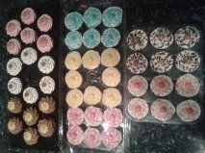
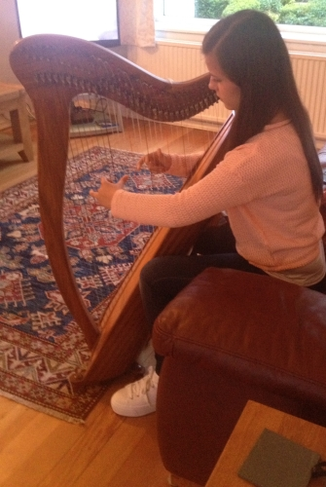
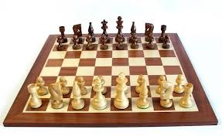
Skills
This is about developing practical and social skills and personal interests.
an activity that allows you to prove you have broadened your understanding and increased your expertise.
  Music
  Life skills
  Science and Technology
  Performance Arts
  Games and Sports
  Creative Arts
  Learning and Collecting
  Media and Communication
  Natural World

Slide 7
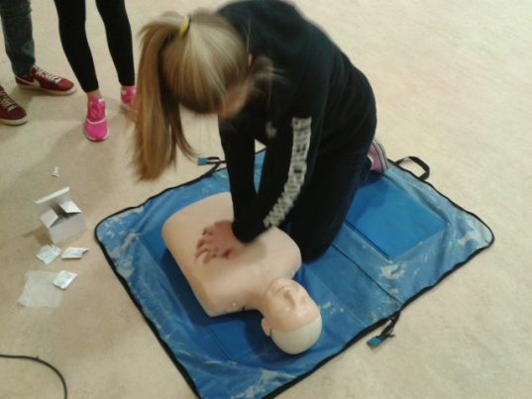
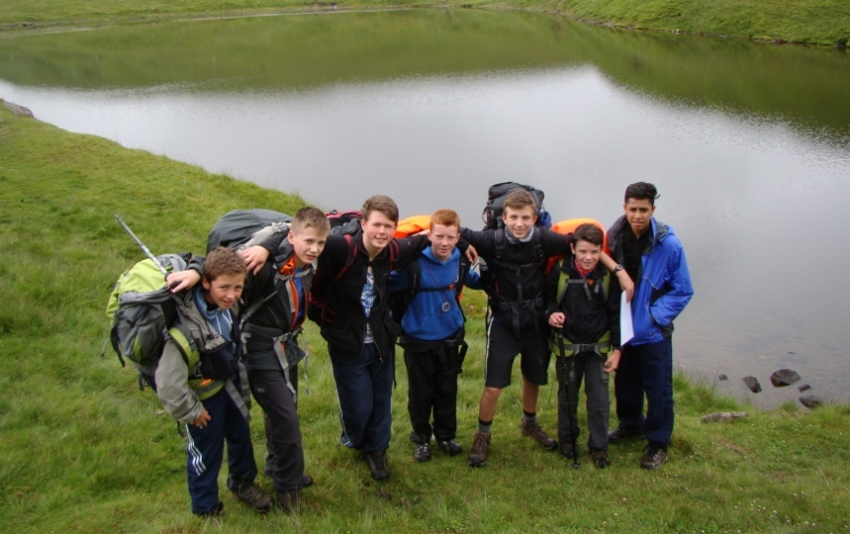
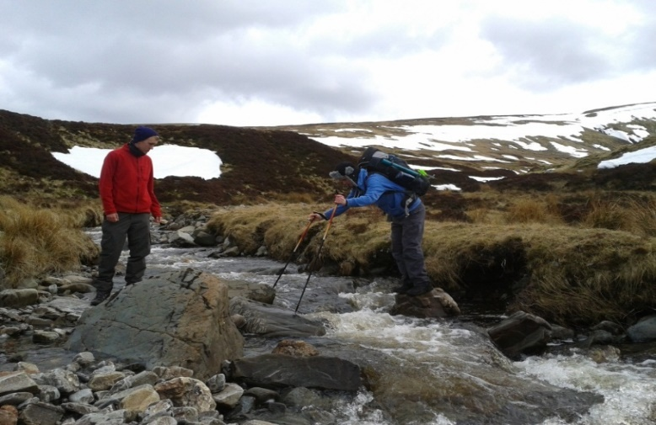
Expedition
  Training
  One Saturday (10am – 1pm) per month
  plus a day in Mugdock park (7 Saturdays).
Groups will plan a route with an aim for their expedition.
All groups carry out a practice expedition at the end of March, and a Qualifying expedition with an Assessor in May (Bronze) or June (Silver).
These expeditions are self-sufficient and remotely supervised.

Slide 8
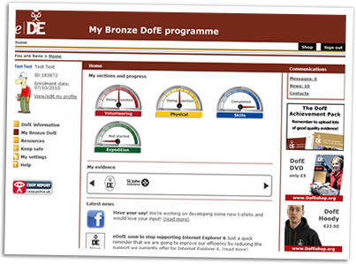

Completing the Award
Each of your sections are logged on www.edofe.org complete with evidence (photos/text etc).
Your D of E leader will sign-off your sections as you submit them.
An Expedition presentation is made and delivered with your group to parents and staff after your Qualifying expedition is completed (August 2020)

Slide 9
How to apply
Application forms available on Tuesday 10th- on the table in the corridor outside Mrs McCloy’s Office
Pick up a yellow application form (S3 Bronze)
Return the completed form to the box on the table by Monday 16th September. If off ill then you/parent must contact the school stating you are applying by the deadline.
Full complete application forms will be selected. If there are more application forms than spaces , then participants will be selected by ballot

Slide 10
Cost
The likely cost for Bronze Award is £130
In all cases the cost covers registration for the Award, transport, Assessor’s fees, supervisor’s fees (where necessary), equipment replacement, staff training (where necessary)

Slide 11
Possible Alternatives
Allander Open Award Centre (AOAC)
Meets in Milngavie on Wednesday evenings
There are spaces for all levels but we have no information on this yet. It is unlikely that they will be able to accommodate direct entrants.
Kirkintilloch Open Award Centre (KOAC)
Meets in - Hillhead, Kirkintilloch on Tuesday evenings.
Applications for all spaces via Alan Smith, EDC Outdoor Education Officer
  www.dofe.org

