Slide 1
Welcome to P4
Mr Baines

Slide 2
Timetable

Slide 3
Task Boards – Differentiating work

Slide 4
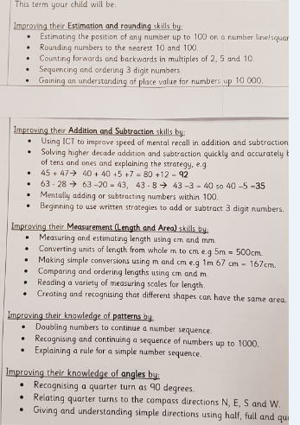
Numeracy

Slide 5
Literacy

Slide 6
Blether stations (collaborative groups)

Slide 7
IDL (Social Studies)
Term 1: Local community study Glasgow
Term 2: Enterprise
Term 3: Local environmental study
Term 4: Significant individual in history
Science: Space and Forces/Electricity (parachute activity-topical science)

Slide 8
Homework

Slide 9
Our classroom
Class captains
Class jobs
Reading corner and scratch map
Class charter – our rights
Birthdays
Growth mindset

Slide 10
Our rights
Article 12
You have the right to give your opinion, and for
adults to listen and take it seriously.
Article 31
You have the right to play and rest.
Article 15
You have the right to choose your own friends and
join or set up groups, as long as it isn’t harmful to
others.

Slide 11
Our rights
Article 19
You have the right to be protected from being hurt
and mistreated, in body or mind.
Article 28
You have the right to a good quality education. You
should be encouraged to go to school to the highest
level you can.

Slide 12
Recognition board

Slide 13
Resources on tables
On your table you will find the following resources to look
through:
Maths textbooks
Reading comprehension box cards
Timetable
Newsletter
Spelling homework
Maths homework

