Slide 1
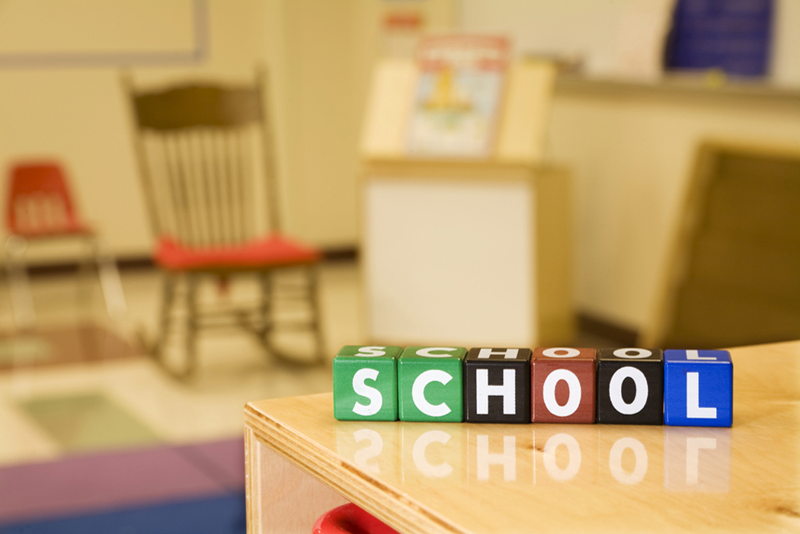
Primary 2/3
Miss Fraser
Meet the Teacher Evening
Tuesday 27th August 2019

Slide 2
P2/3 Timetable ( under normal circumstances)
 | 9 – 9.45 | 9.45 – 10.30 |  | 10.45 – 11.30 | 11.30 – 12.15 | 1 -2pm | 2- 3pm
Monday | Numeracy |  |  | Literacy: Reading and Phonics |  | Social Studies/IDL | PE (Miss Parker)
Tuesday | Literacy: Taught Writing |  |  | Numeracy |  | STEM | IDL: Expressive Arts
Wednesday | PE |  | Spelling | Literacy: Reading and Comprehension/ Talking and Listening |  | Numeracy | Social Studies/ IDL
Thursday (Mrs Smith) | Literacy : Grammar and Punctuation |  |  | Maths / Problem Solving |  | RME | Hand-writing | French
Friday | Literacy: Reading and Phonics |  |  | Numeracy |  | Assembly/Song Practice/Family Grouping/ Pupil Voice Circles (Miss Parker) | Health and Wellbeing (Mrs Smith)

Slide 3
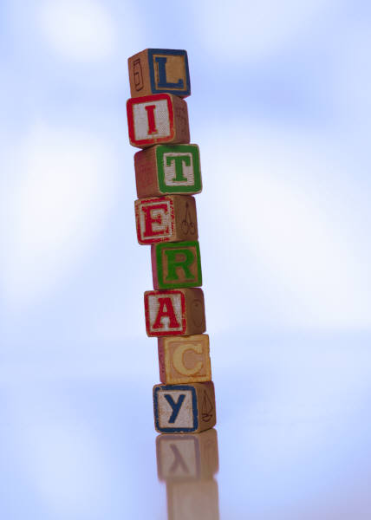
Literacy
Reading
Writing
Spelling and Phonics
Talking & Listening
All areas will be differentiated
by ability e.g. different success
criteria will be provided.

Slide 4
Literacy Focuses This Term
Primary 2
Writing
Recount writing (Weekend News etc).
Push to ensure correct letter formation and punctuation is used
Reading
Different strategies to read tricky words
Using Ben Bear resources (using the picture ,sounding out, reading on etc)
Spelling and Phonics
Revising sounds previously learned (ch, sh, th, ng)
Learning diagraphs (ay, ea, ow…)
Primary 3
Writing
Recount writing (Weekend News etc).
Push to ensure correct letter formation and punctuation is used
As we progress we will be looking for use of openers and descriptive words
Reading
Different strategies to read unknown words
Developing comprehension skills
Spelling and Phonics
Revising previously learned sounds such as magic e, aw and ow

Slide 5
Language
Lesson Structure
Warm Up
Teaching/ Groups
  Active
  Written
  Collaborative task
  Choice/ Extension
Plenary
Monday
Reading Skills
Tuesday
Taught Writing
Wednesday
Phonics and Reading / Talking and Listening
Thursday
Grammar and Punctuation
Handwriting
Friday
Reading and Comprehension

Slide 6

Literacy Task boards
Example
T: Reading
I: Phonics/ Comprehension Task
P/G: Literacy games
C: Sharing of new learning
I: Phonics/ Comprehension Task
P/G: Literacy Games
T:Reading
C: Sharing of new learning
Play: Open area
T: Reading
Target: Phonics/ Comprehension Task
C: Sharing of new learning gained through play

Slide 7
Language Activities
Sentence structure activities
Spelling games within their choice boxes
Whiteboards – show me
Sound recognition games
Book Area
VCOP – challenge cards
Writing area - writing templates and story building

Slide 8



Resources
Book banding - Various Reading Scheme
Bug Club – at home and in class
Reading Comprehension – Prim Ed: reading skills and genres, EDC Intervention Programme ( Big Book Lessons)
VCOP Pyramids and writing packs
Write to the Top: Ros Wilson
Phonics games and practical resources ( magnetic letters/flashcards)

Slide 9

Numeracy and Maths
Number, Money & Measure
Shape, Position & Movement
Information Handling
Problem Solving

Slide 10
Numeracy and Maths
Primary 2
This term we will be focusing on:
Counting forwards and backwards to 50.
Identifying numbers to 50 and writing them correctly.
Counting in 10s to 100.
Identifying numbers before and after a number to 50.
Adding two numbers to 20 (8 + 3 = 11 / 12 + 7 = 19)
Subtracting numbers to 20 (12 – 2 = 10 / 20 – 4 = 16)
Properties of 2D shapes (edges, vertices, names, links to real life)
Primary 3
This term we will be focusing on:
Adding and subtracting numbers within 100.
Counting on and back in 1’s, 2’s, 5’s and 10’s.
Verbalising 3 digit numbers e.g.327 = three hundred and twenty-seven.
Place value e.g. 327 represents 3 hundreds, 2 tens and seven ones.
Properties of 2D shapes (edges, vertices, names, links to real life)
Properties of 3D shapes
Symmetry

Slide 11
Format of a normal maths lesson
Warm Up – Counting games/ recalling facts/ paired tasks
Groups (differentiated)
  Teaching time
  Written task
  Active/Group Task/ICT
  Extension Tasks – Baskets with games and consolidation activities
Plenary – Sharing learning & Assessing children’s learning ( orally/ written)
  E.g. Exit passes

Slide 12
Maths Task boards
Example
Mental Maths
Teacher
I: Written task
Paired task/ challenge
C: Plenary (game, sharing, assessment)
Mental Maths
Paired task/ challenge
Teacher
I: Written task
C: Plenary (game, sharing, assessment)
Mental Maths
I: Written task
Play
Teacher
C: Plenary (game, sharing, assessment)

Slide 13
Activities | Resources
Mental Maths Counting games Team games Maths Around the world/ Mystery Number/ Find the answer/ Find the question/ Ordering Maths games linked to key concepts being taught – Addition Bingo/ Time bingo/ division snap/ matching times tables Written Work Scottish Heinemann Scottish Heinemann Active Maths | Education City Website ( School membership) Websites Whiteboards Digit flip cards Hundred Squares Dice Maths games Measuring Implements Splat Square

Slide 14
Homework
Weekly reading books using the book banded scheme
Targeted written homework may be provided when your child requires further practice on a concept
If your child would like additional reading material then they will each have a log in for Bug Club

Slide 15



Health and Wellbeing
Term One:
With Mrs Smith:
Friendships and feeling lonely
Emotions
Road Safety
World of Work
With Miss Fraser:
Growth Mindset
PE:
Fitness
Ball Skills

Slide 16


RME
Term one:
Introduction to RME
Miracles
RME will be covered by Mrs Smith

Slide 17


Science
This term we will be learning about energy sources.

Slide 18



French
This term:
Numbers
Alphabet
Greetings
Weather

Slide 19
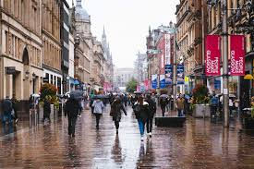
Social Studies Topic
Term One – Glasgow
What makes a city?
What do they need to function?
Links to our local community
Transport
Weather
Glasgow Artists
If you have anything interesting related
to our topic, feel free to send these in for
your child to show the class or get in touch
with me.
Children work in collaborative groups to teach social aims:
Turn taking
Eye contact
Leadership etc

Slide 20





Classroom
Class Jobs
Growth Mindset
Birthday Bees
Work to Be Proud Of
Book Nook

Slide 21

Class Charter
Primary 2/3 have chosen 3 Articles to focus on throughout the year for our Rights Respecting School :
Article 28:The right to learn
Article 31:The right to play
Article 19:The right to be safe

Slide 22

Promoting Positive Behaviour
Individual points – House Points
Recognition Board – whole class approach to achieve one goal

Slide 23

Assessment is for Learning (AifL)
Traffic Lights
2 Stars & a wish
Peer marking/ Self Assessment
Teacher Comments
Exit passes

Slide 24

Thank you!
Thank you for attending Meet the Teacher 2019.
I am thoroughly looking forward to working with your children and getting to know them over the coming year!
Tea and coffee are available in
the hall – please help yourself!

